Slide 1
Collecting seeds
Collection,
preparation
and storage

Slide 2
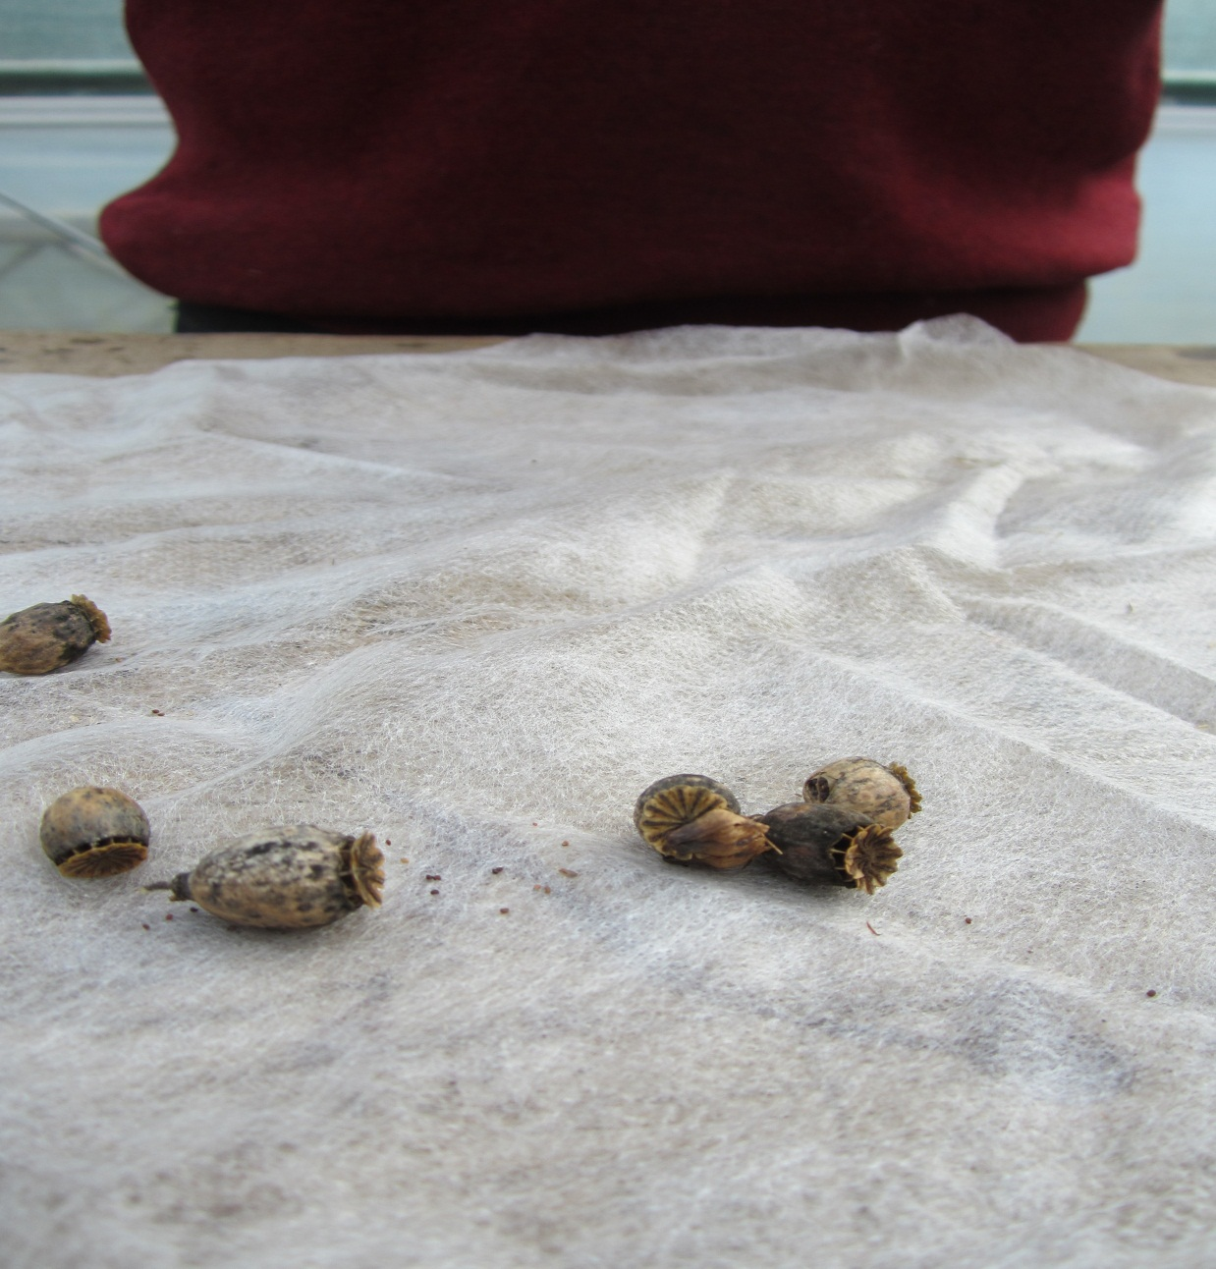
Seed which is dispersed through a capsule is wrapped up in a fleece bundle as shown. This allows the seed to naturally leave the fruit and there is no condensation.

Slide 3
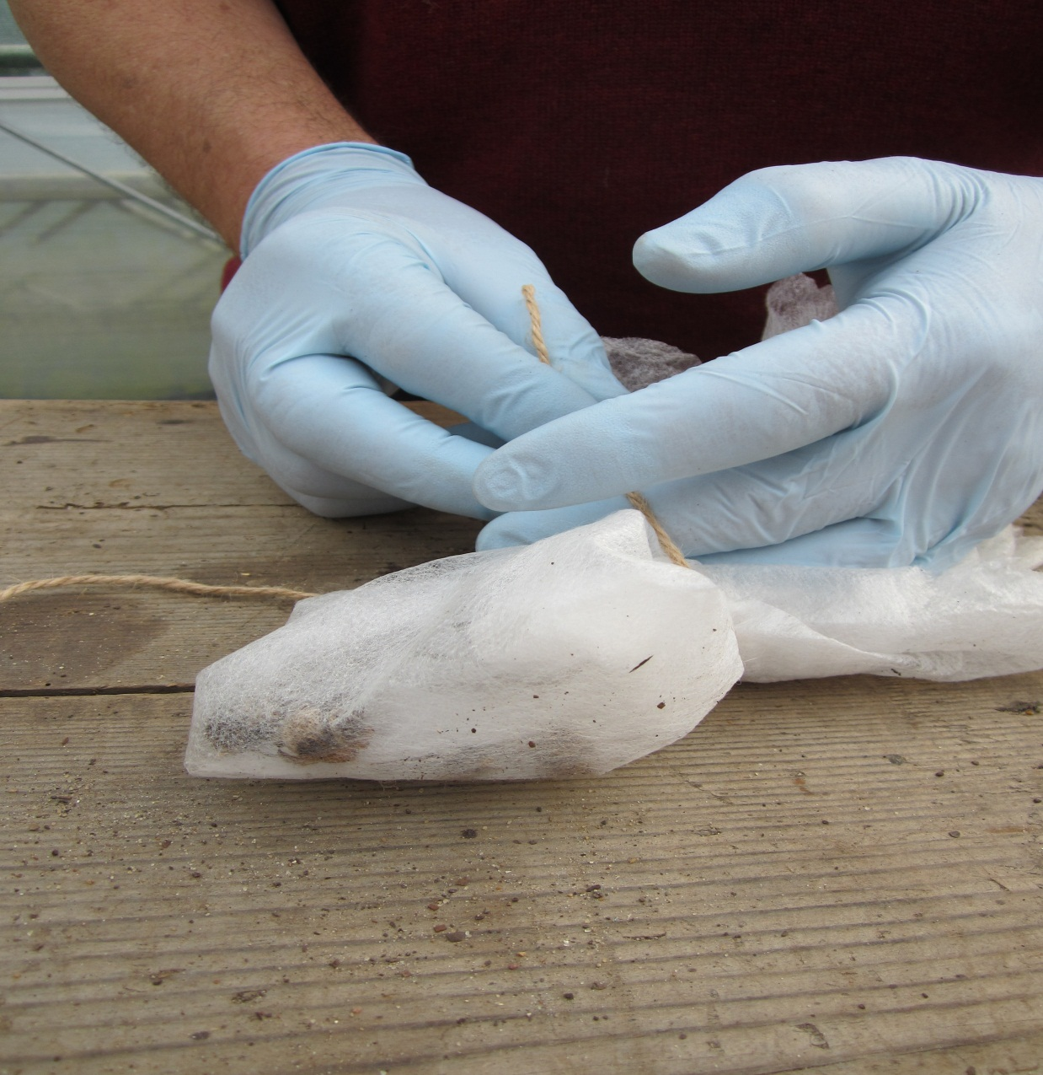
Seed which is dispersed through a capsule is wrapped up in a fleece bundle as shown.

Slide 4
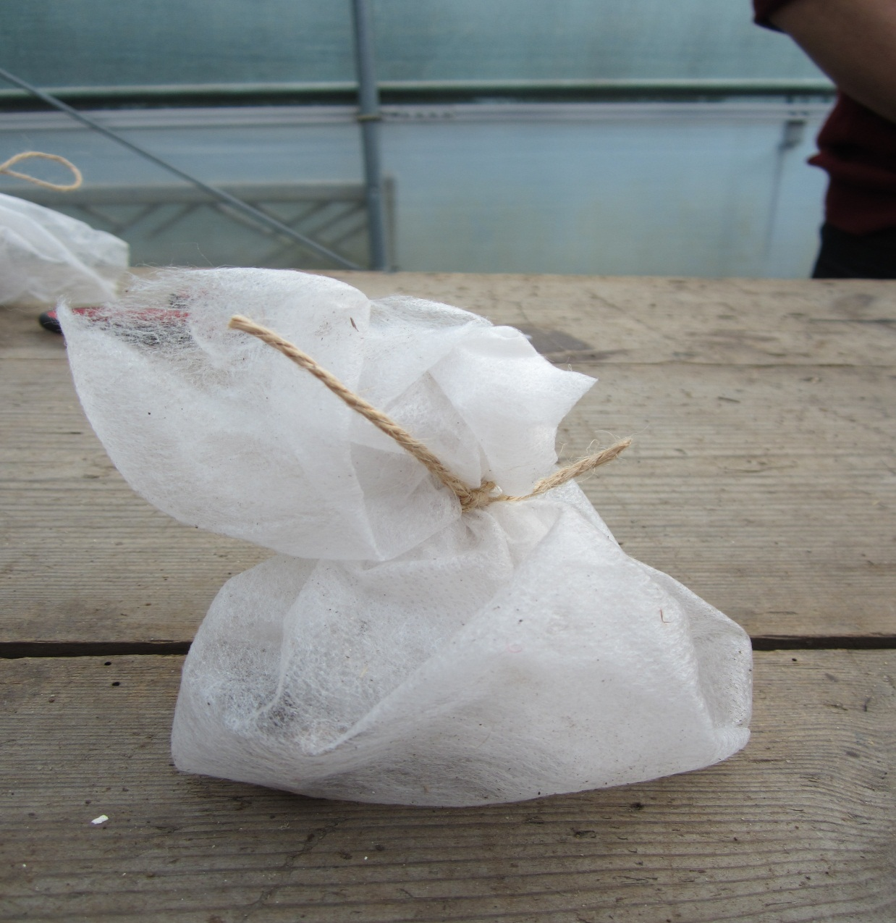
This allows the seed to naturally leave the fruit and there is no condensation.

Slide 5
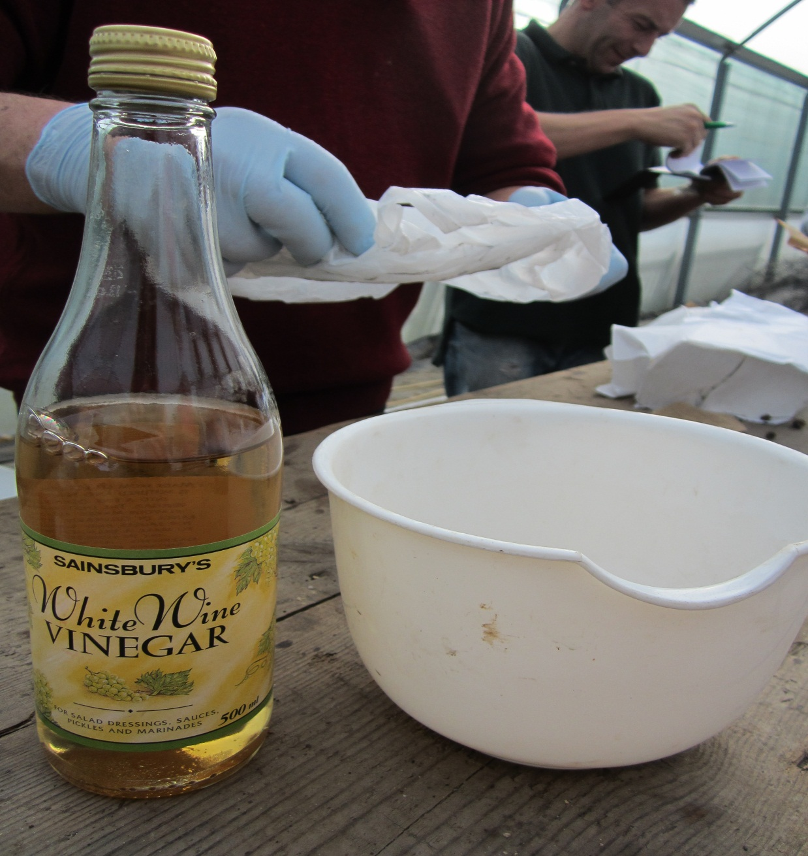
White wine vinegar can be used to chemically scarify the seed testa. A hard coated seed is soaked in the vinegar for between 20 and 30 minutes.

Slide 6
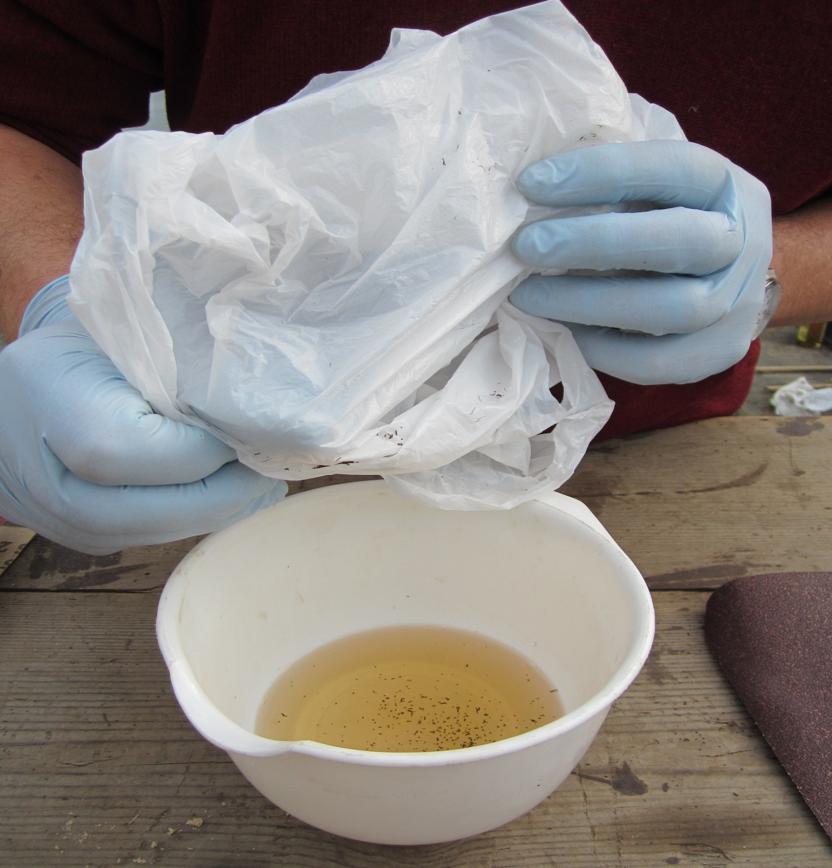
White wine vinegar can be used to chemically scarify the seed testa. A hard coated seed is soaked in the vinegar for between 20 and 30 minutes.

Slide 7
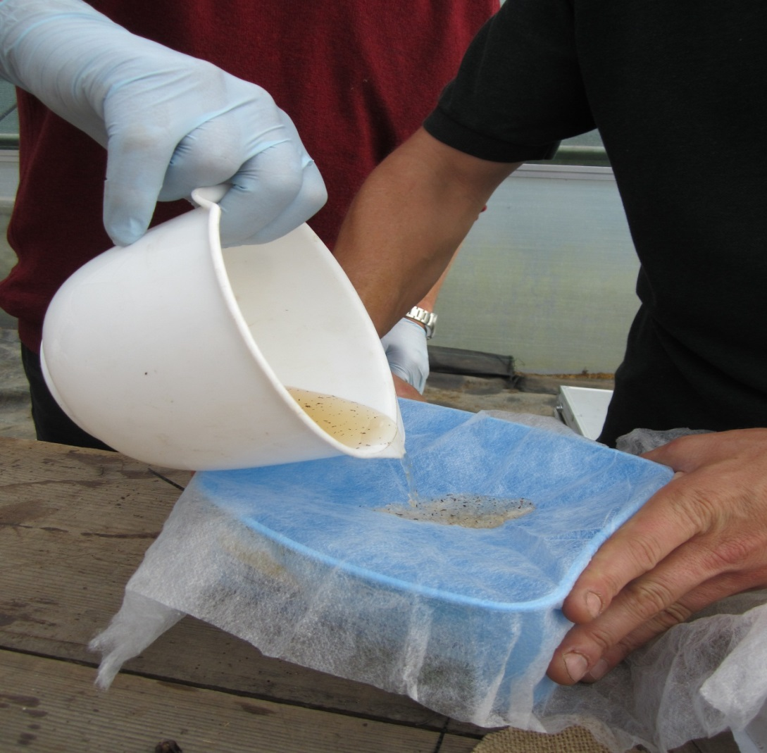
After the 20 to 30 minutes the seed is placed on thin grade fleece.

Slide 8
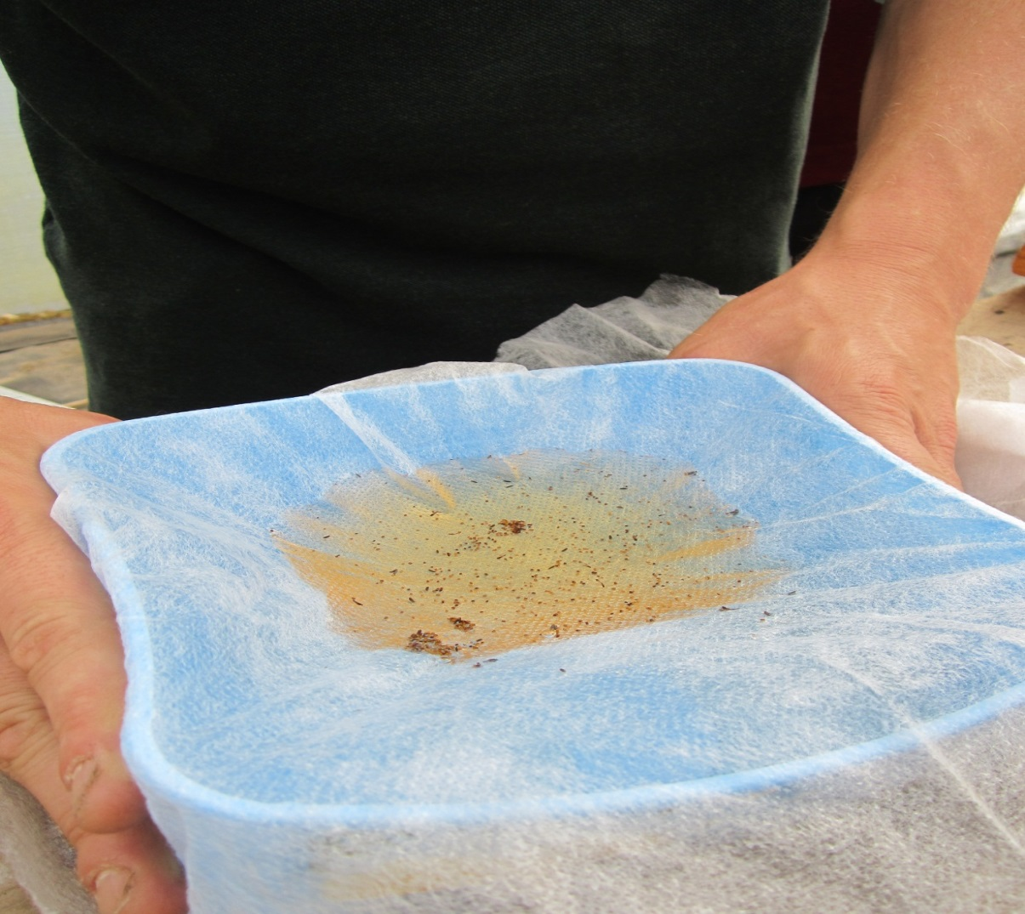
After 2 to 3 hours the vinegar will have soaked through the fleece leaving just the seed.

Slide 9
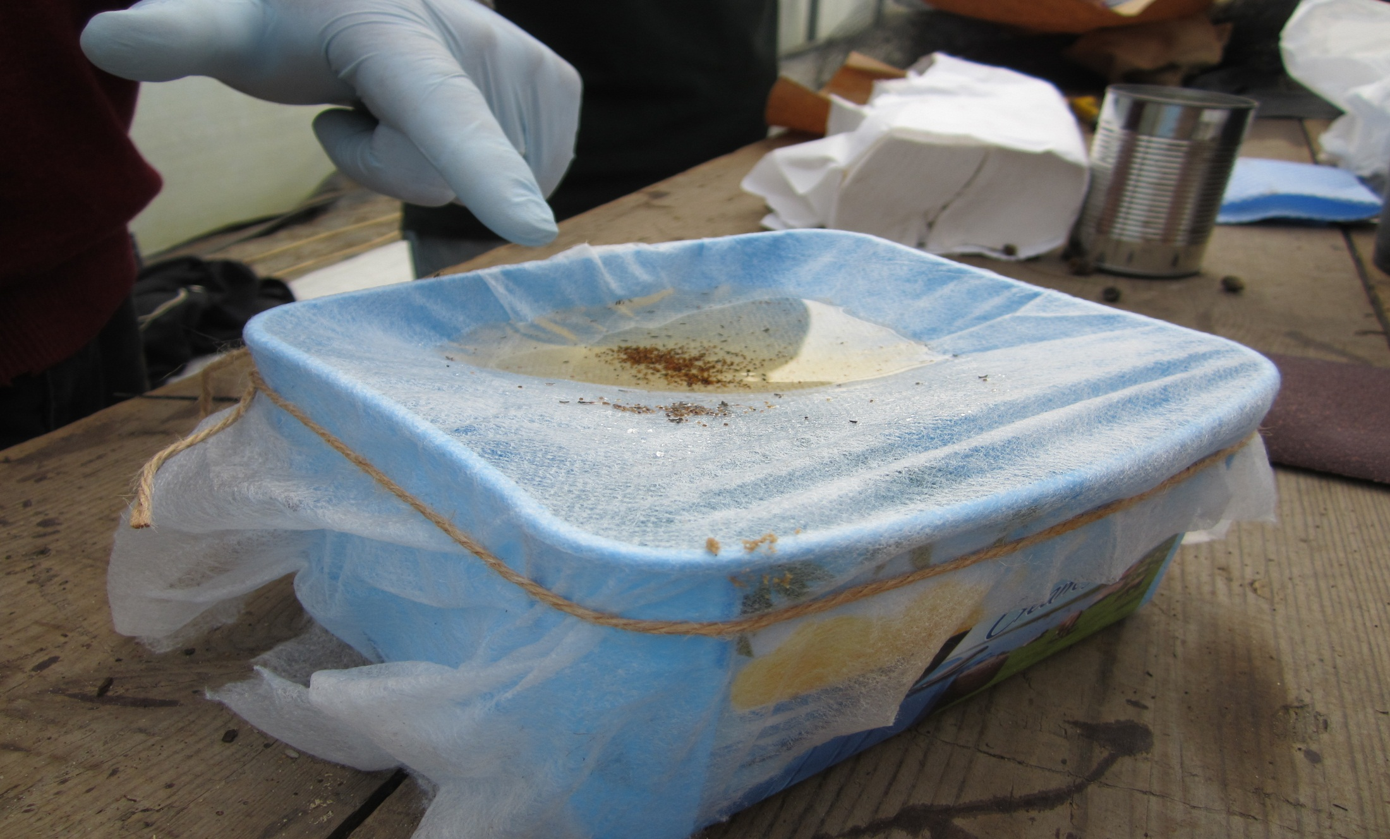
After 2 to 3 hours the vinegar will have soaked through the fleece leaving just the seed which can dry on the fleece

Slide 10
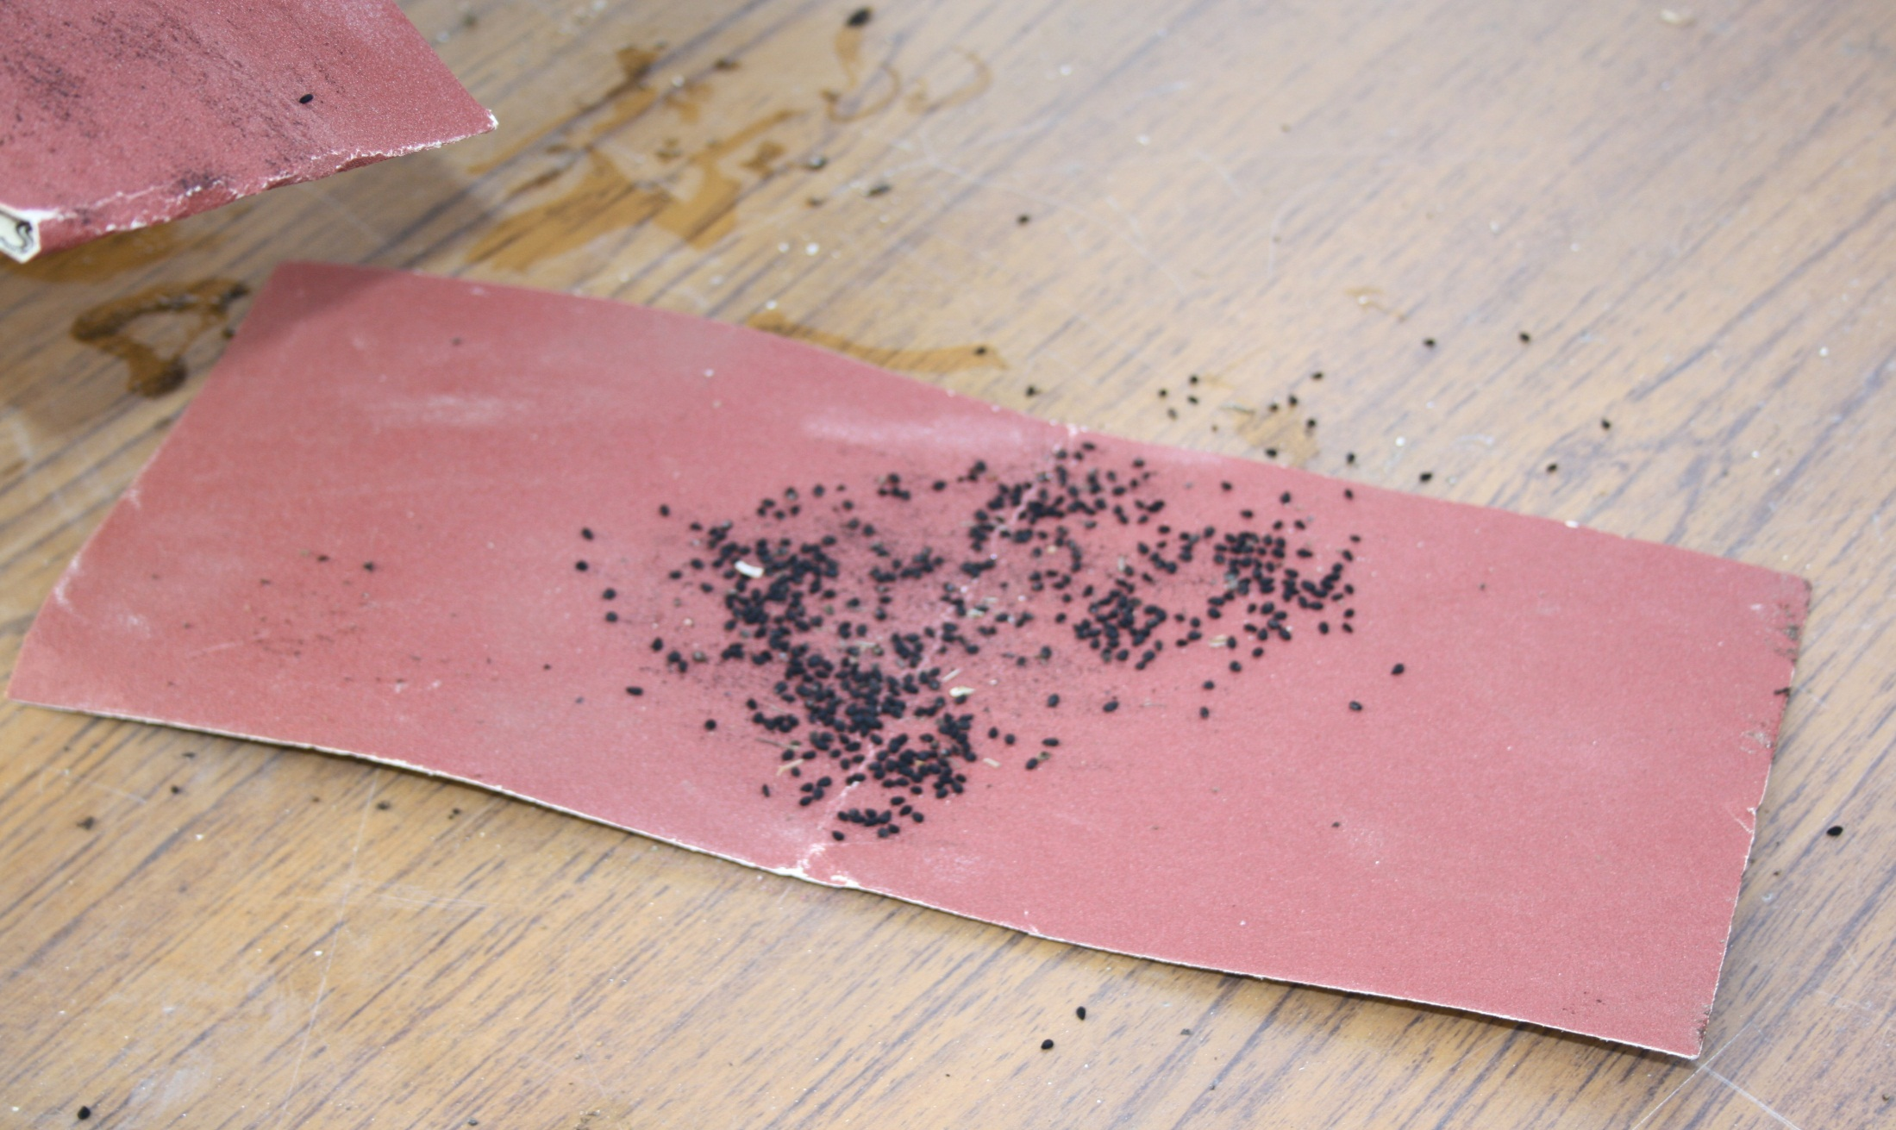
Physical scarification of hard seed can be achieved by using a metal-based grinding paper. This is similar to sandpaper, but much harder and long-lasting.

Slide 11
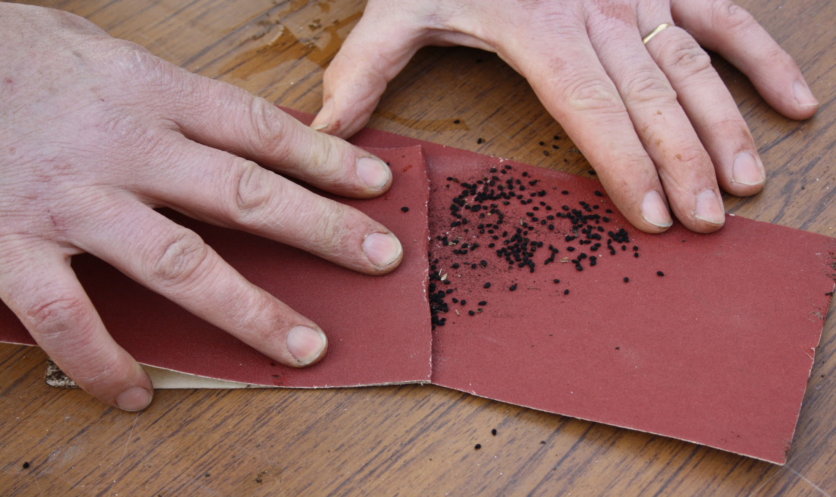
Two layers of the grinding paper are used in order to gently scarify the seed.

Slide 12
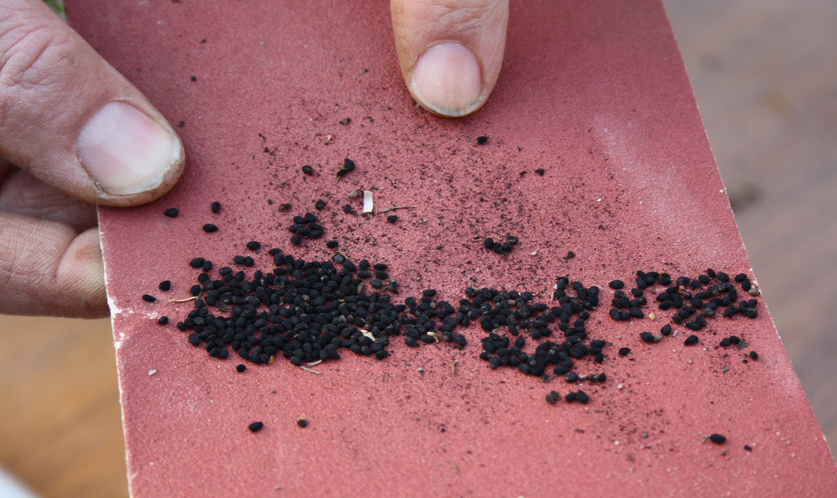
It is important not to over scarify the seed as too much damage may be made to the testa, resulting in problems with future germination. The dust seen in this photograph, as shown by the yellow arrow, is the testa breaking up. This is the result of scraping the seed for 20 seconds and is about the right amount of scarification for this seed.

Slide 13
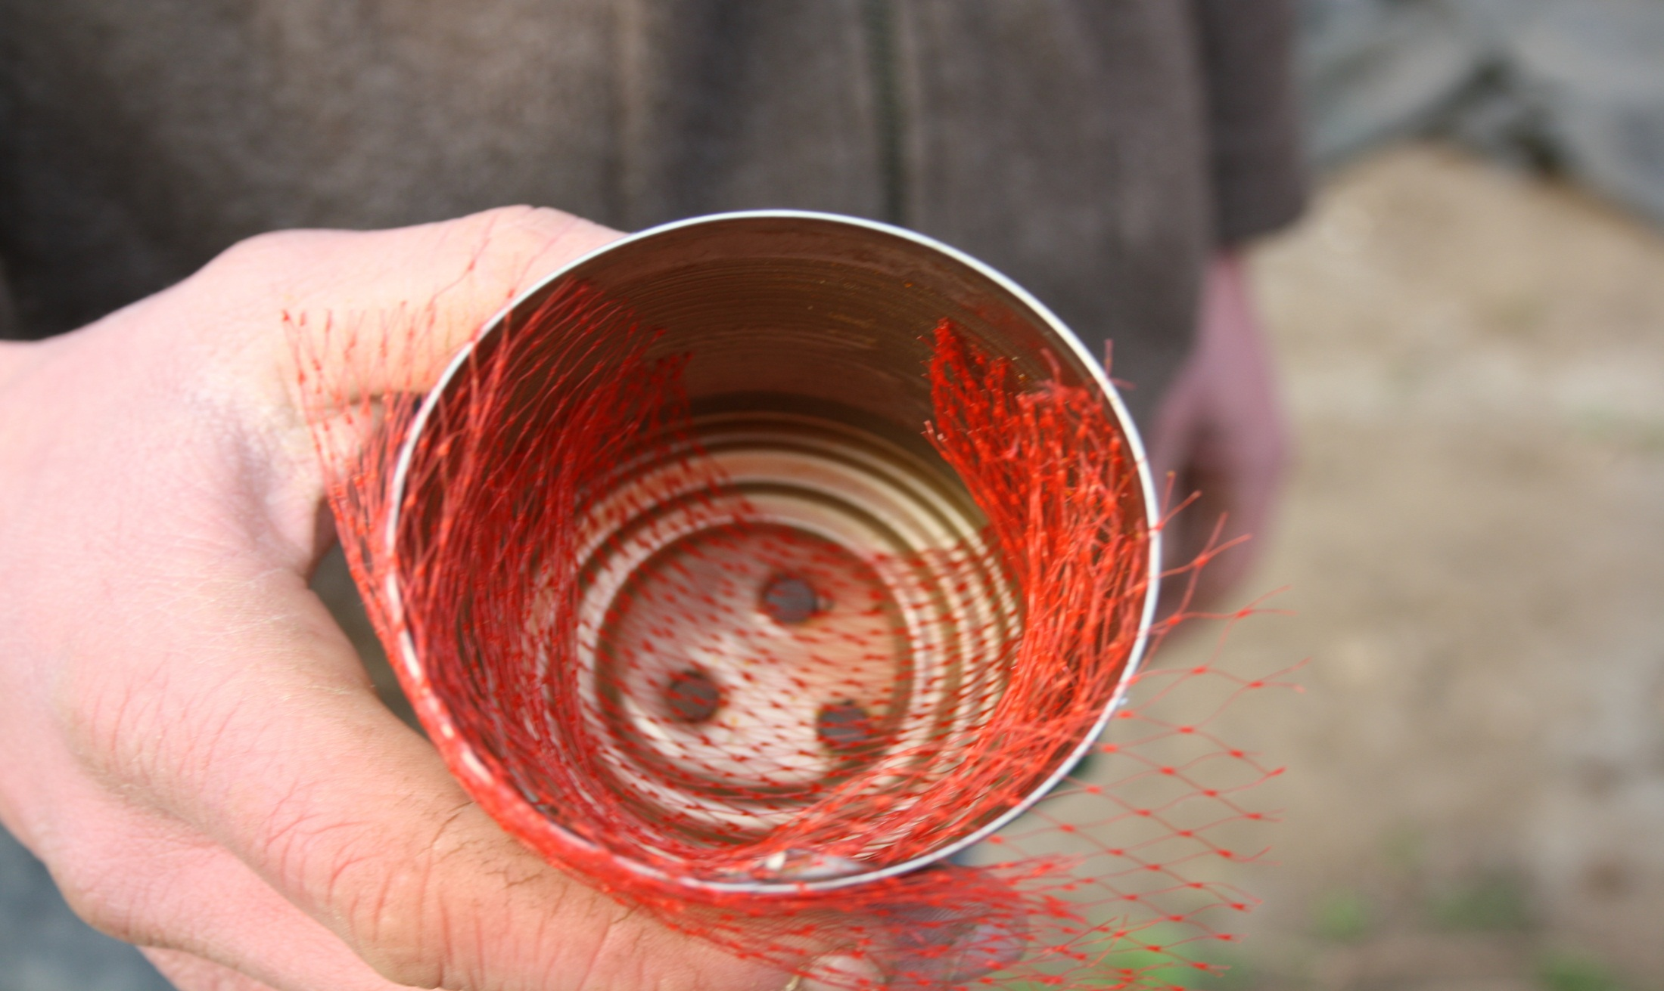
For smaller seeds, cold stratification can be achieved using a baked bean container. Note the drainage at the bottom of the container. The fine net has been placed at the bottom to prevent potential pests entering the container.

Slide 14
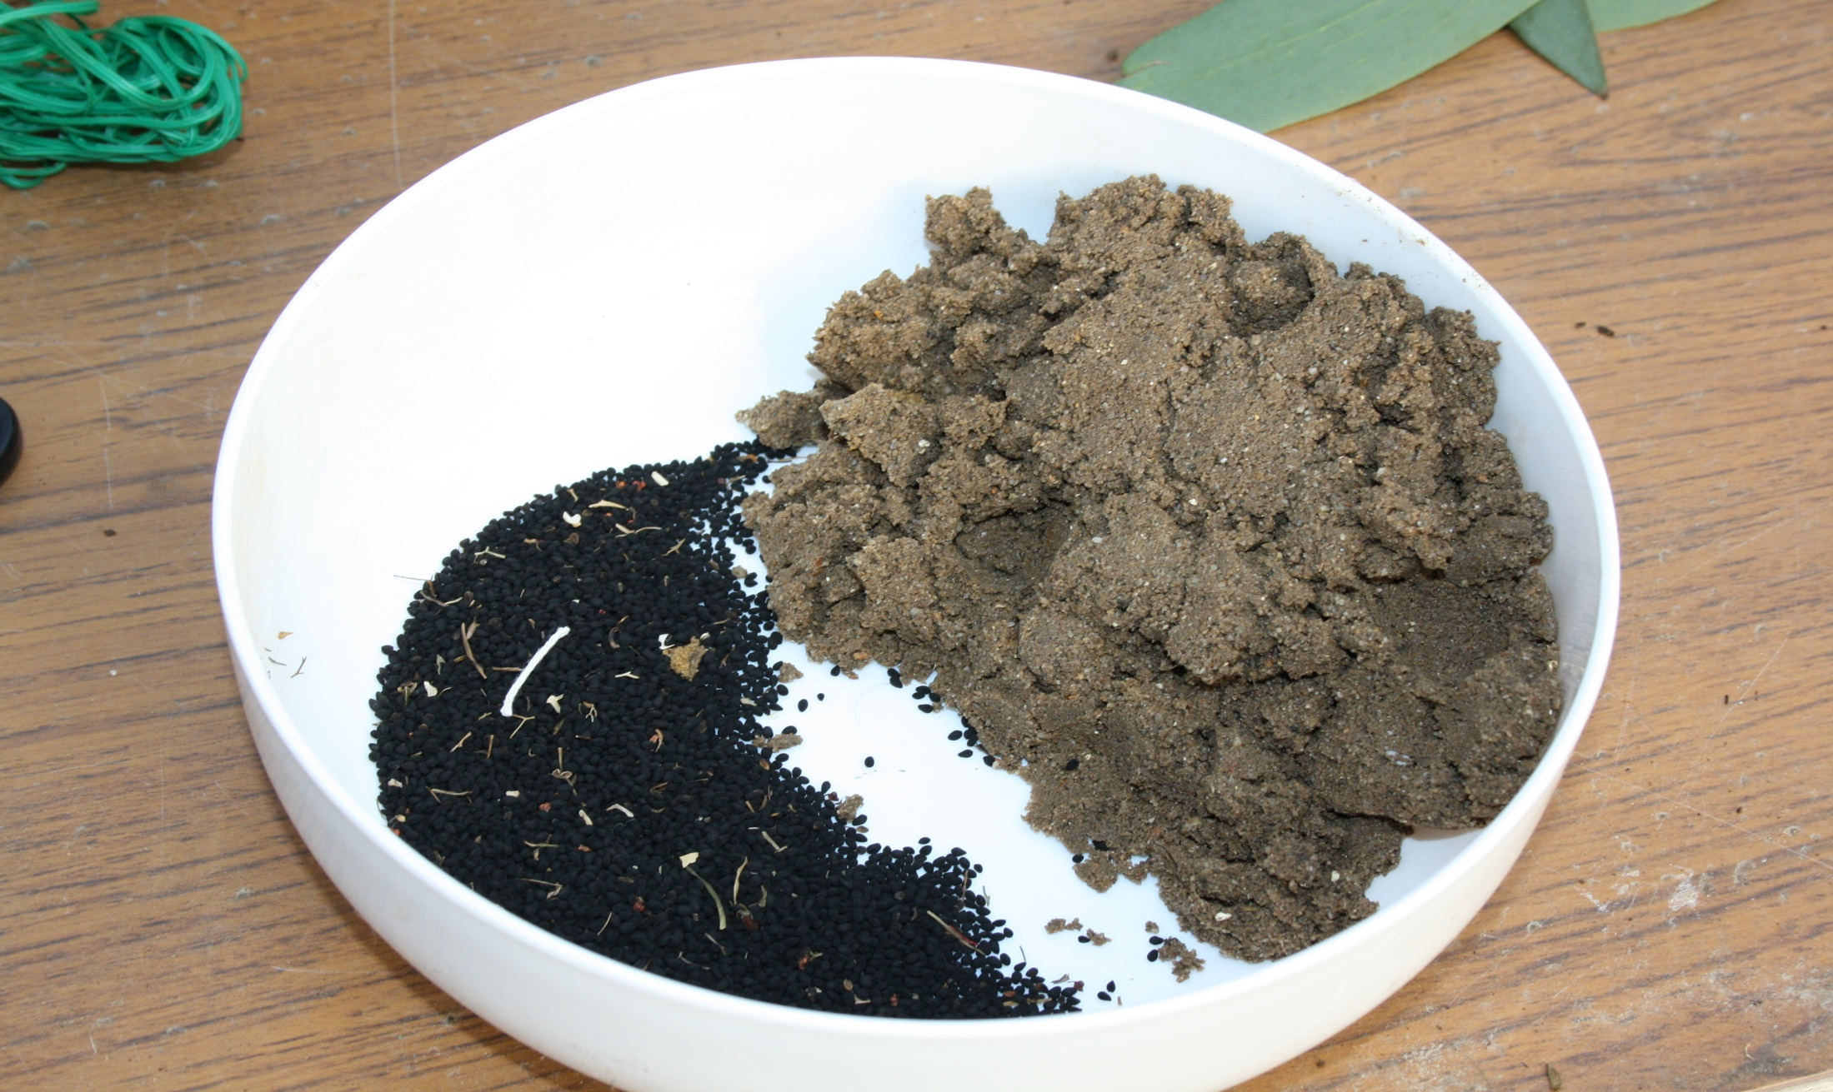
The seed is mixed with sand at a ratio of one part seed and three parts sand by volume. The seed and sand are thoroughly mixed together.

Slide 15
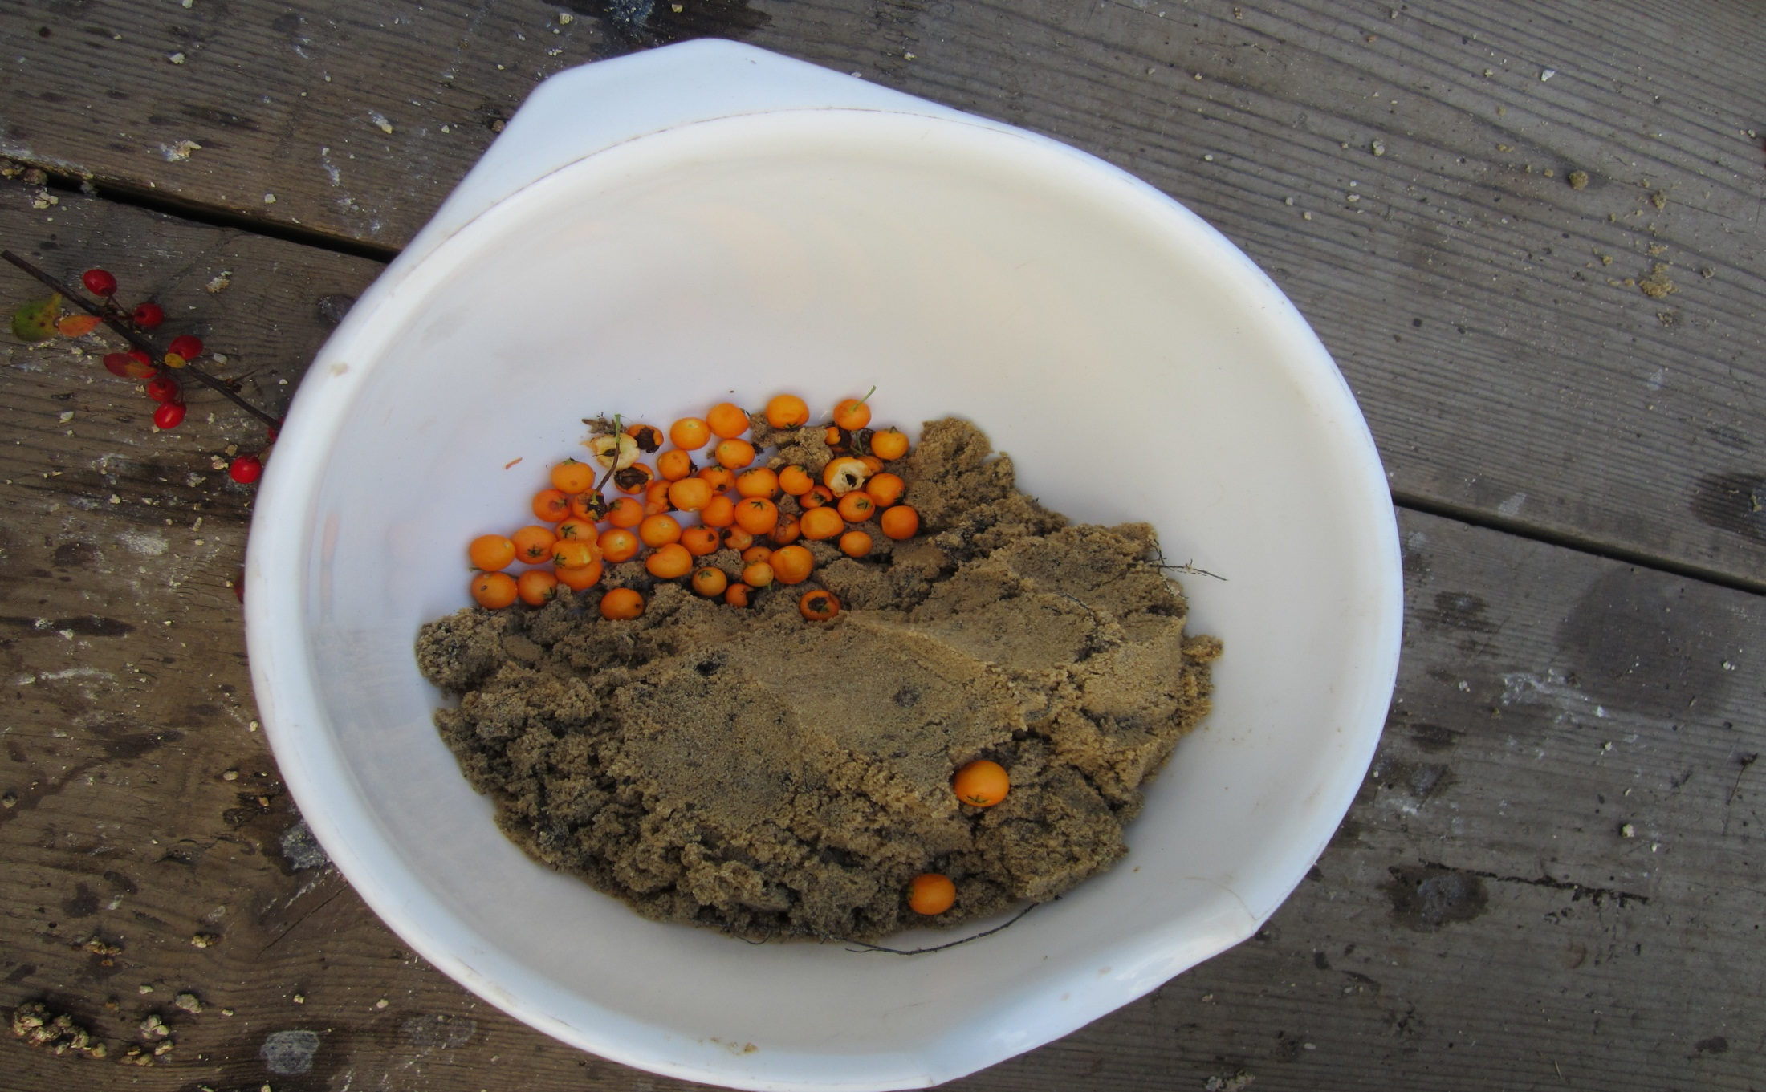
For the stratification of the berry, mix one part berry by two parts sand by volume.

Slide 16
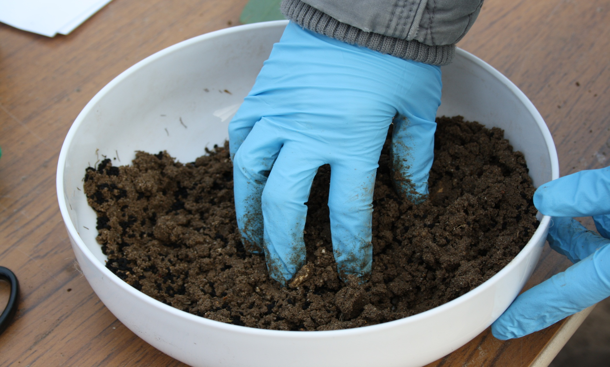
The seed and sand mixed together. The sand must be moist.

Slide 17
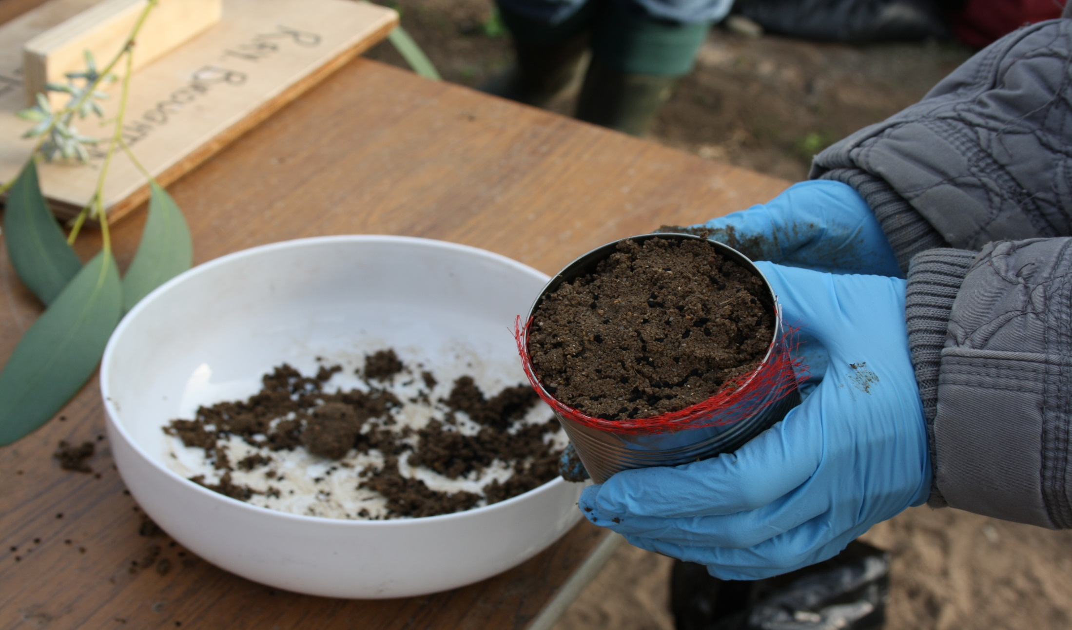
The sand/seed mixture is placed in the container. The mixture is firmly consolidated in the container.

Slide 18
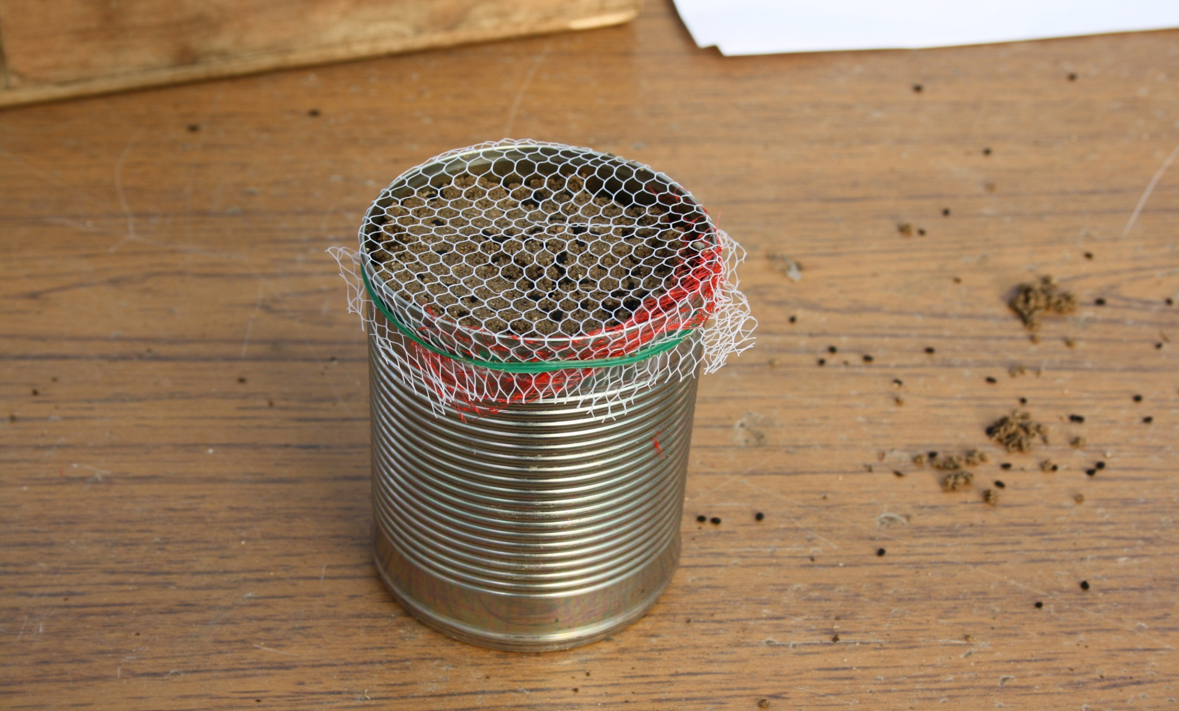
A strong nylon net is placed over the container, which is secured with wire to prevent vermin damage. The container must be exposed to the elements to allow stratification of seed.

Slide 19
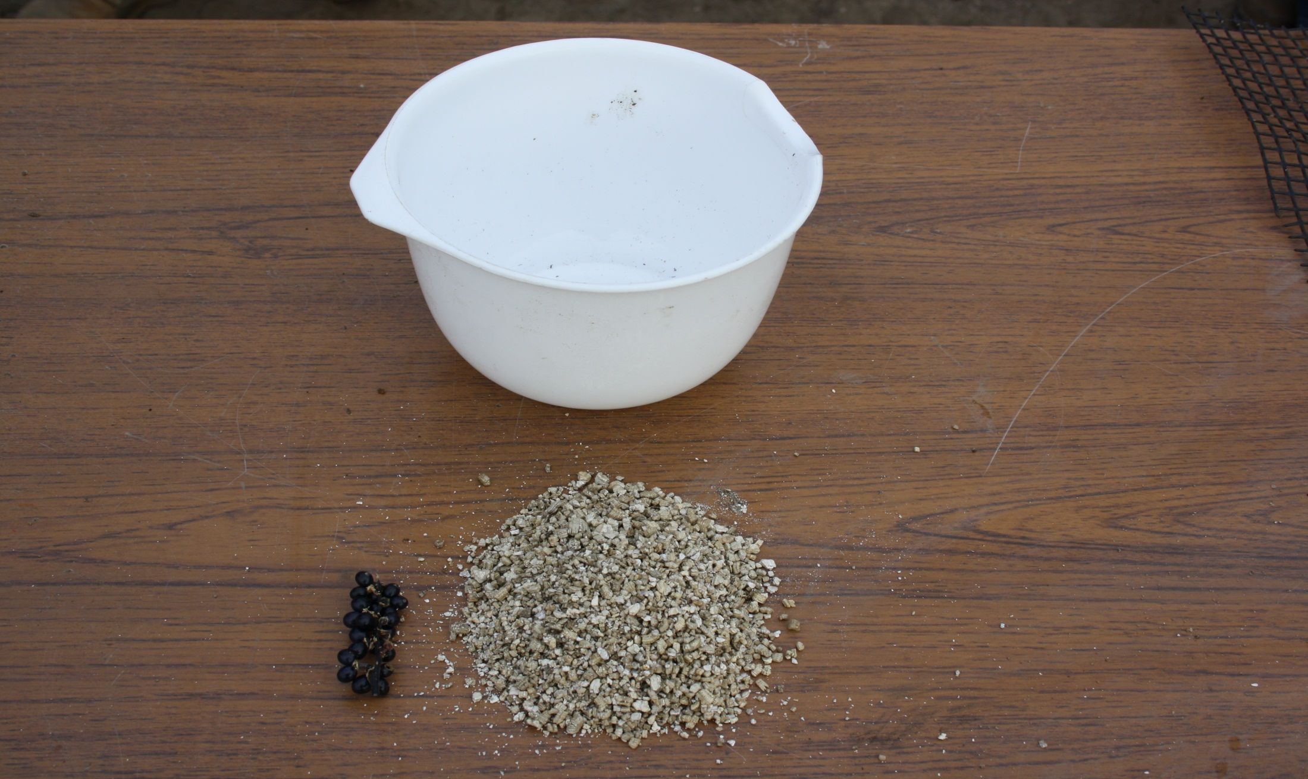
In warm stratification which relates to tropical plants, a waterproof container is used. The berries are not physically separated from each other on the stalk. Horticultural vermiculite is used instead of sand. The ratio is one part berry and three parts vermiculite by volume.

Slide 20
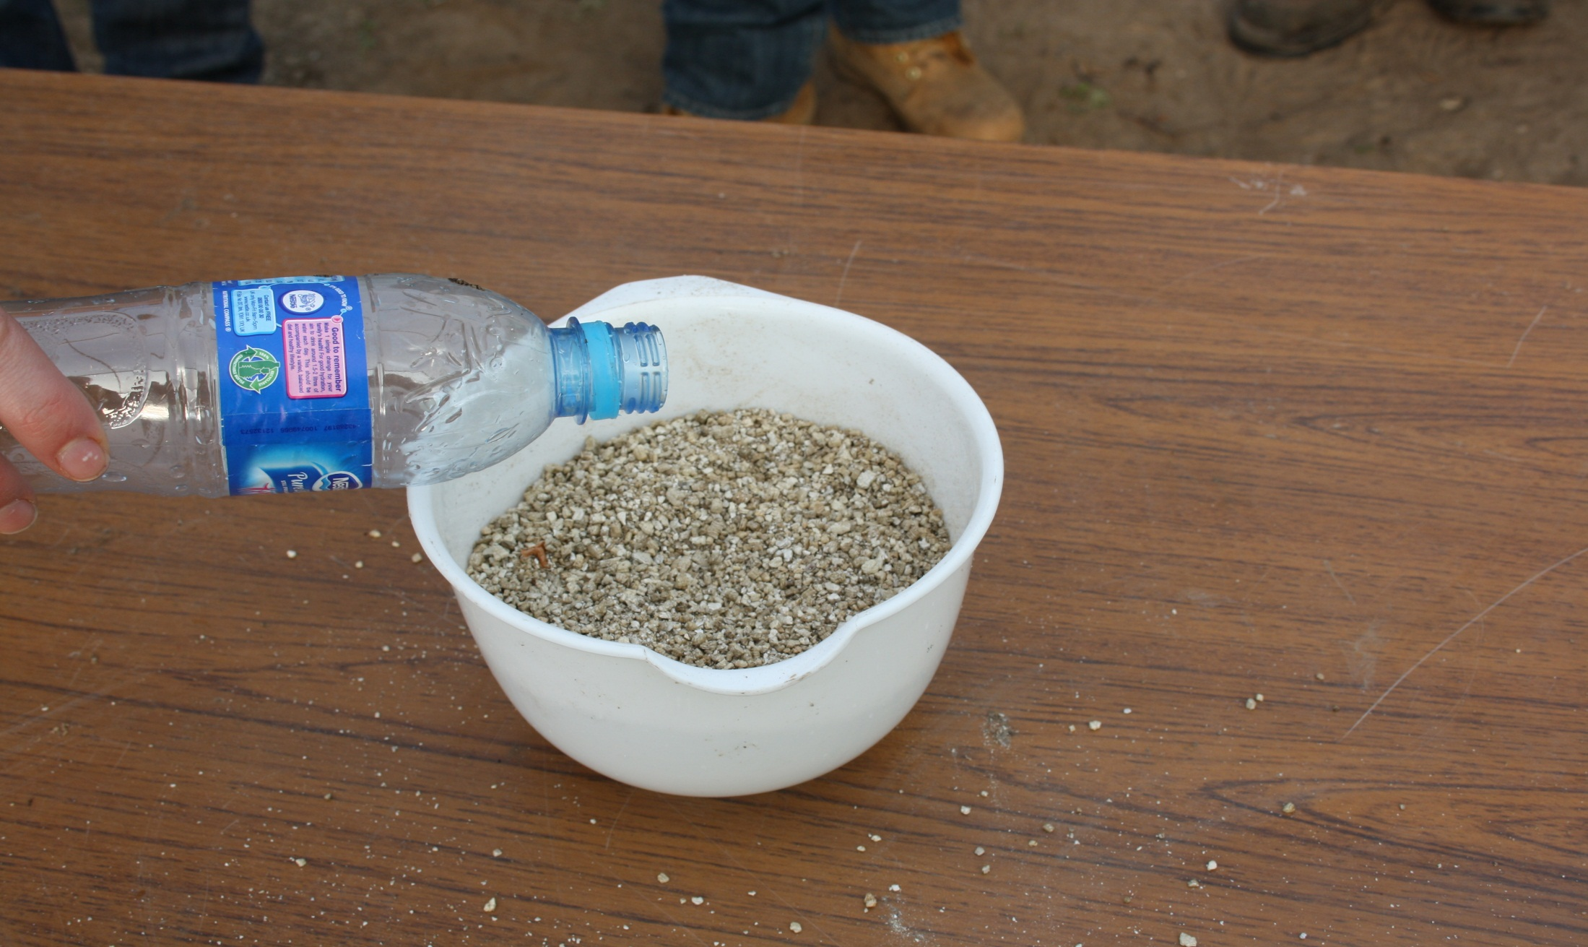
After mixing the berry and vermiculite, water is added to the vermiculite to ensure that it is moist.

Slide 21
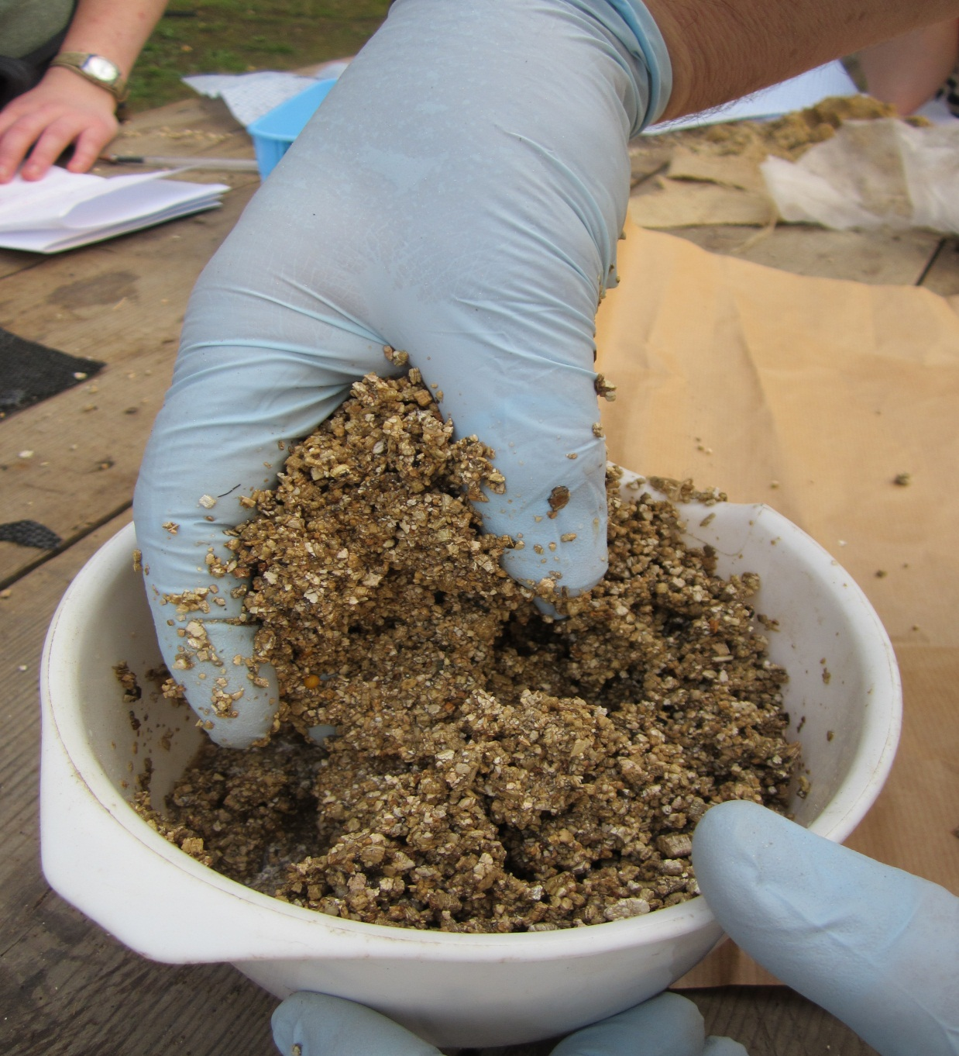
It is important to thoroughly mix the seed or berry with the moist vermiculite.

Slide 22
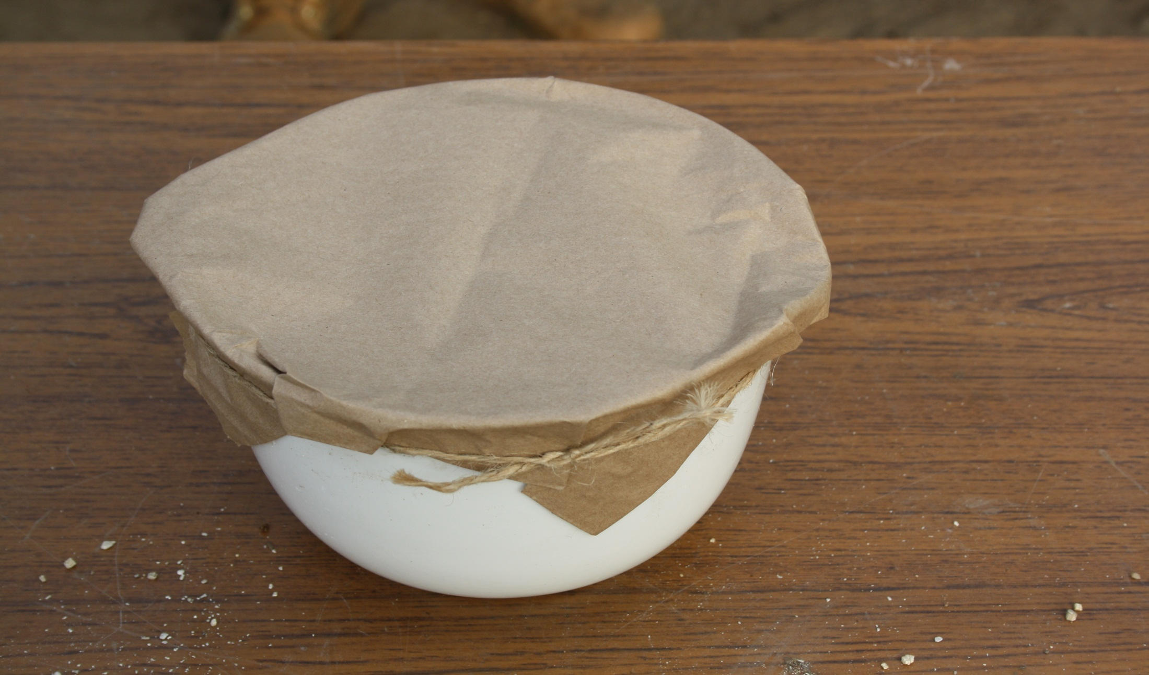
A breathable membrane such as paper is tied over the container. The container must be placed in a warm environment. In this case the berry will shrivel thus exposing the seed. At the end of warm stratification, the seed/vermiculite mixture is sown in a container.

Slide 23
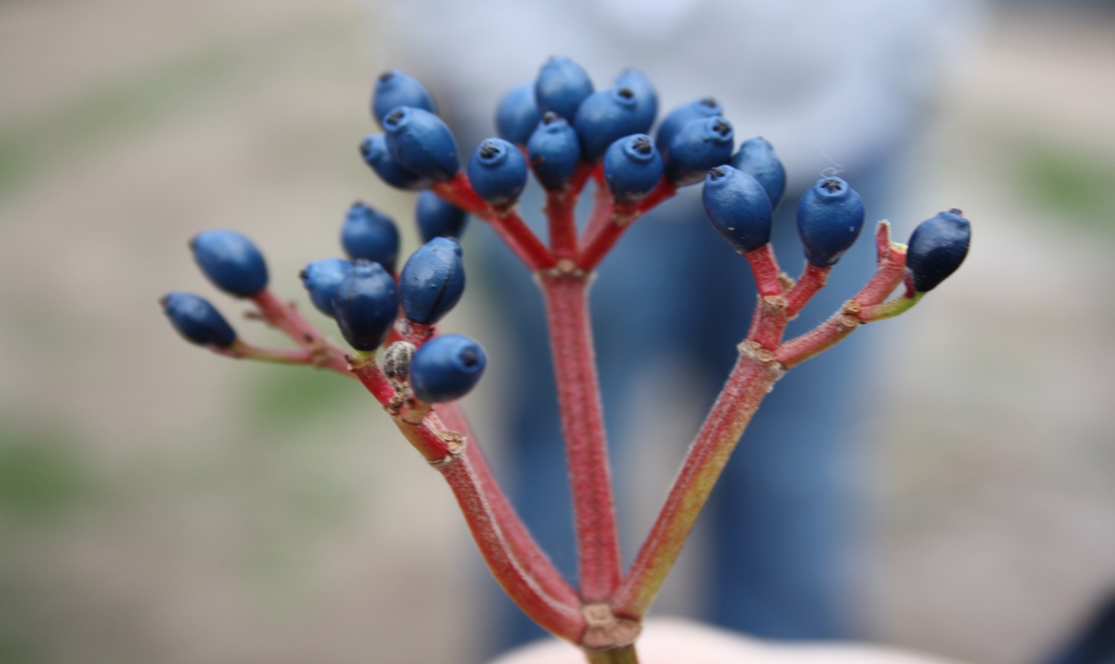
Berries can be macerated to release the seed from the berry.

Slide 24
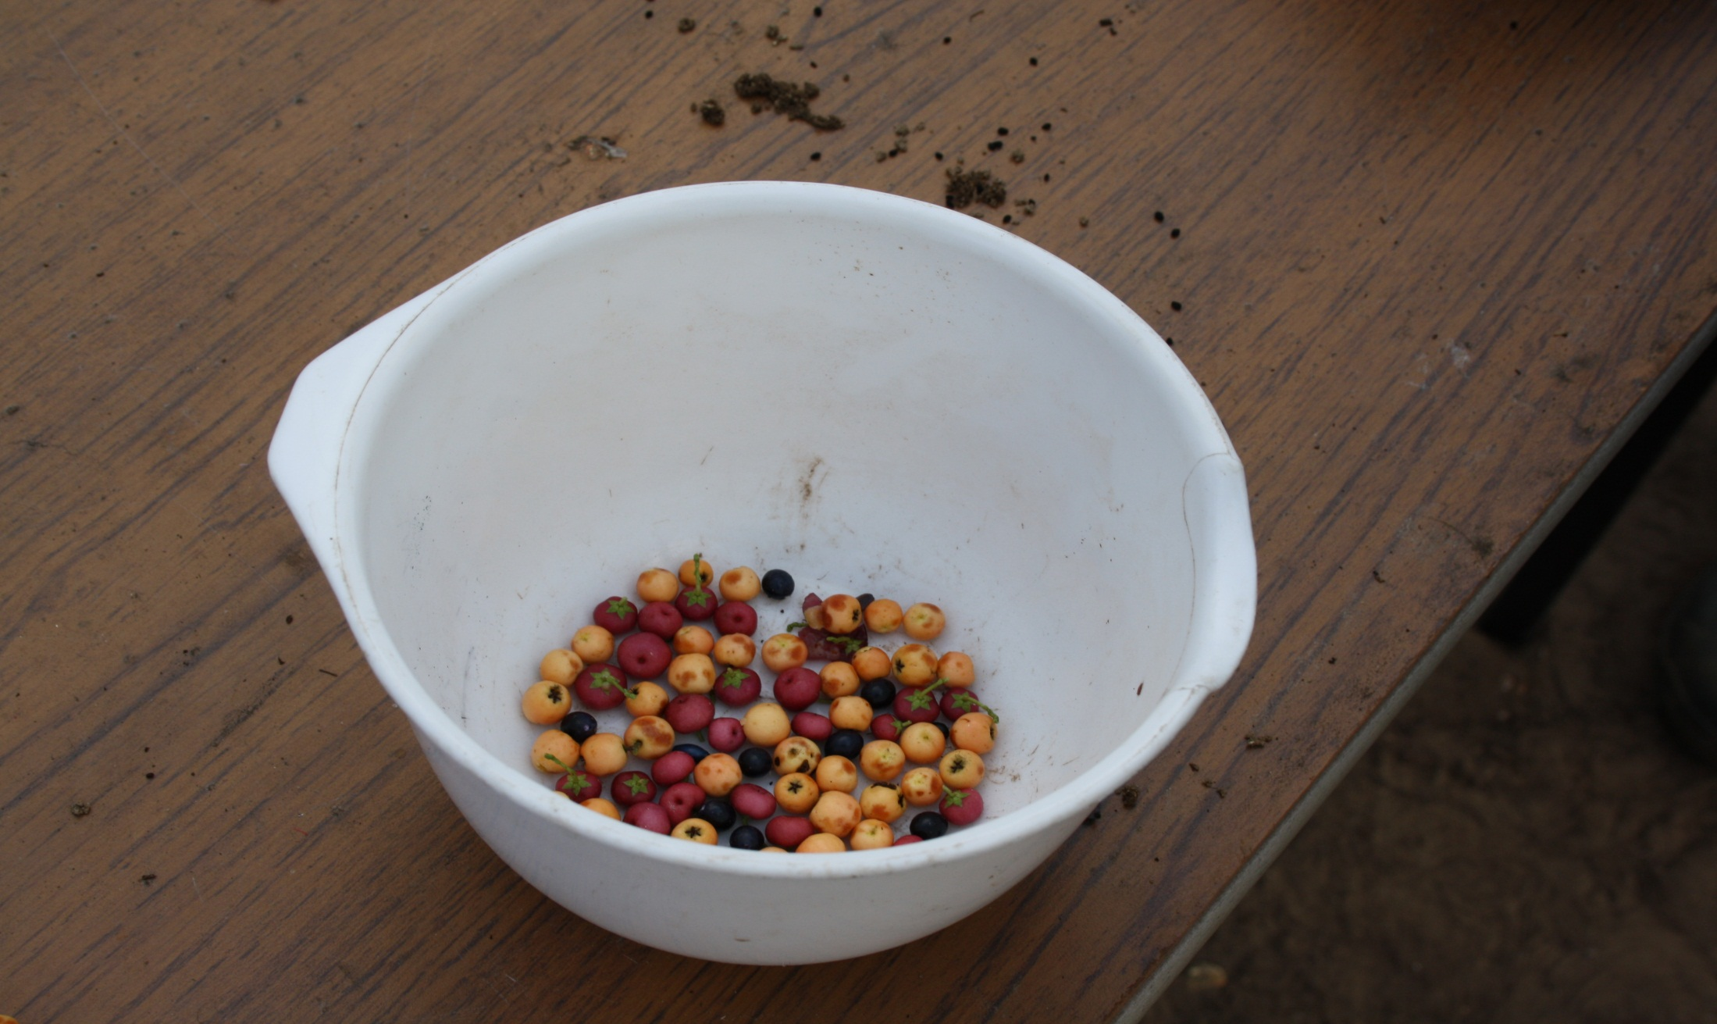
A typical range of berries, which can be physically macerated.

Slide 25
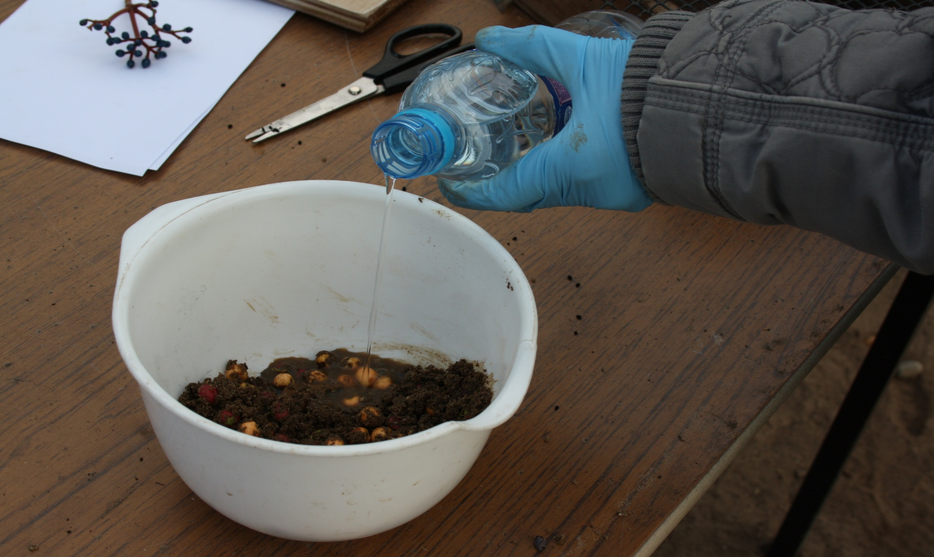
The berries are mixed with coarse horticultural sand, at the ratio of one part berry and three parts coarse sand by volume. It is important that the sand is moist. The best results are achieved if the seed and sand is allowed to soak in water for at least two hours before attempting maceration.

Slide 26
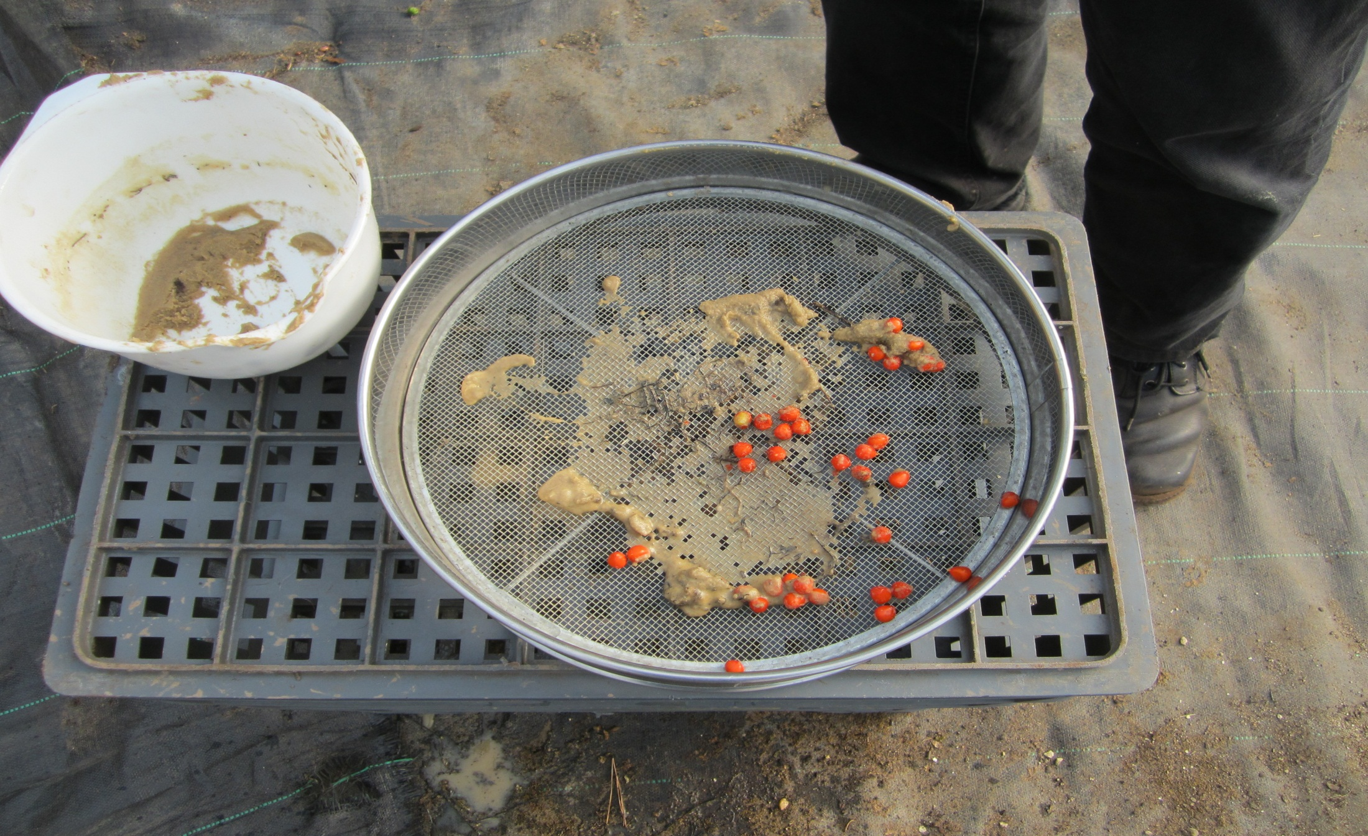
Fine sand mixed with the berry will helps the maceration of the berry to release the seed.

Slide 27
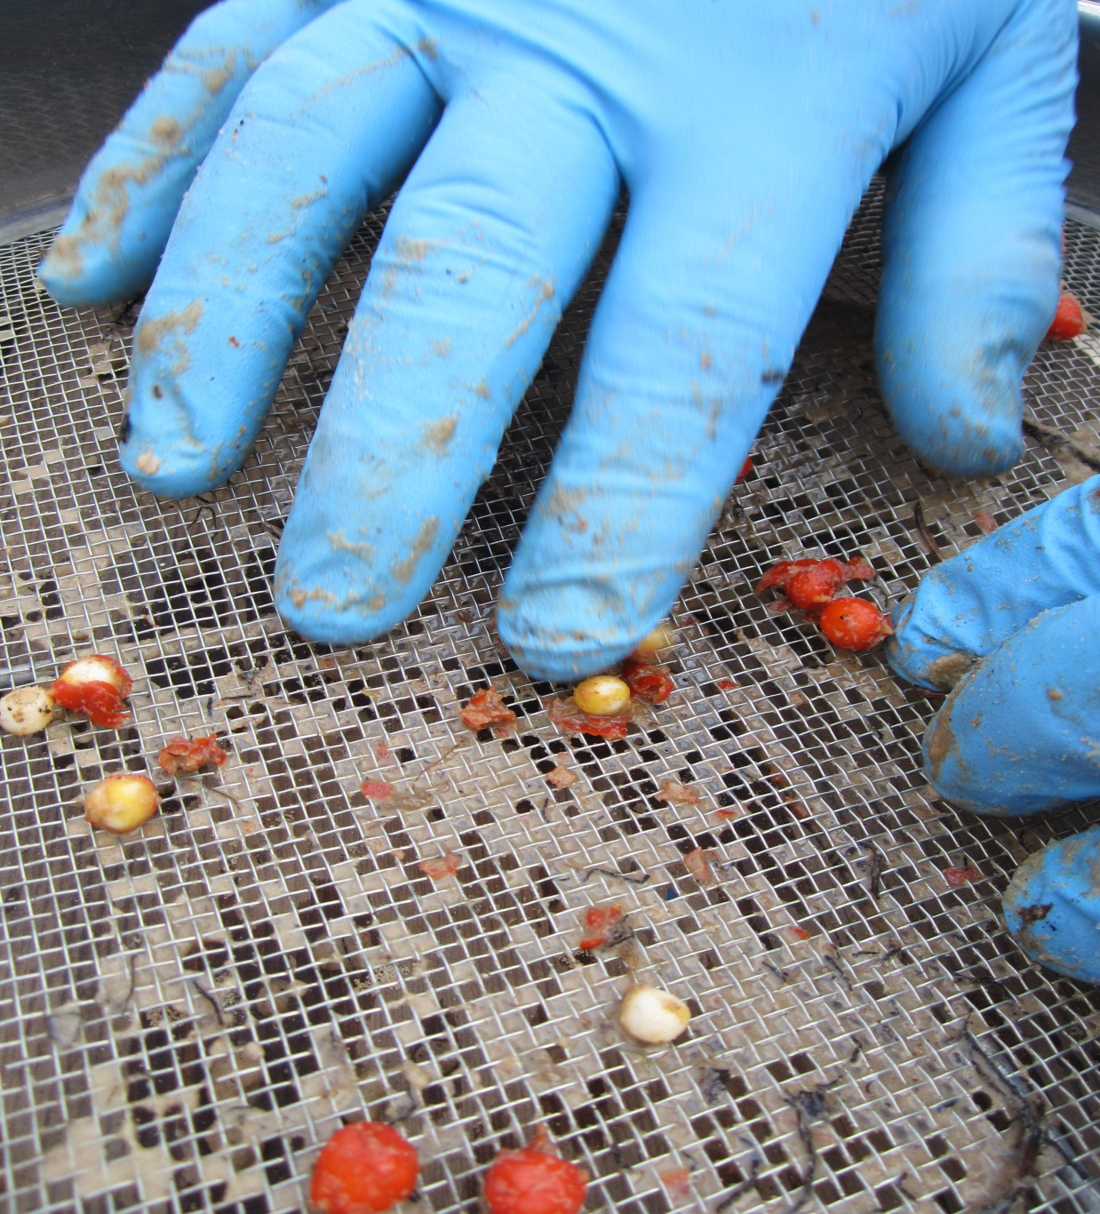
Fine sand mixed with the berry will help the maceration of the berry to release the seed.

Slide 28
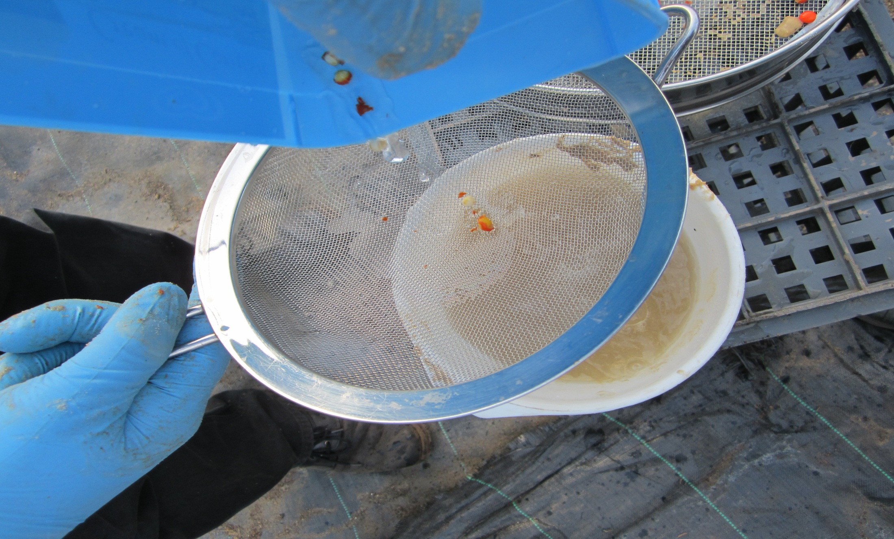
Using a fine sieve to remove all the remaining fruit, leaving just the seed.

Slide 29
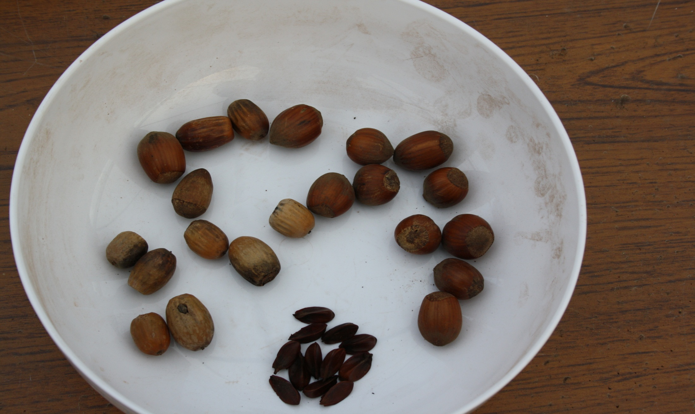
A range of hard indehiscent seed suitable for pine bark/compost stratification.

Slide 30
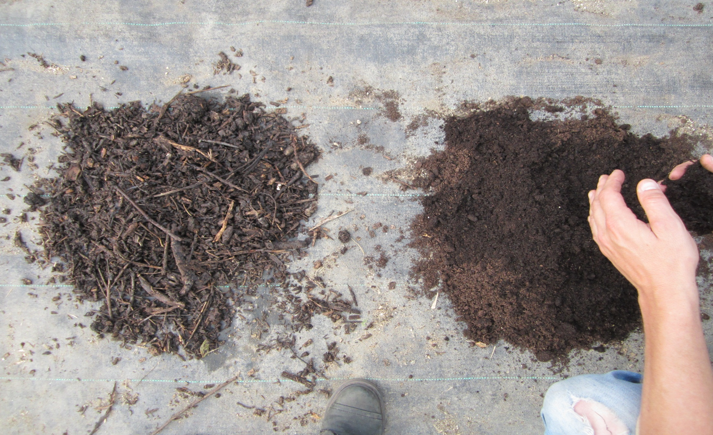
On the left is the pine bark, which will provide the ethylene to stimulate germination. On the right is well-rotted garden compost, which is used to provide bacteria to break down the hard case of the nut.

Slide 31
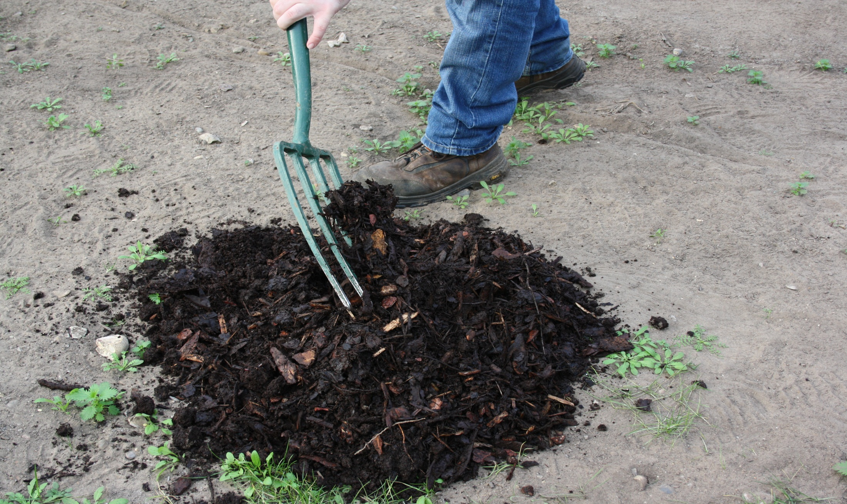
Pine bark and well-rotted organic matter are mixed together. The ratio of ingredients is 50:50. The organic matter provides bacteria to assist the breakdown of the nut. The pine bark allows good drainage and aeration and also releases ethylene, which if absorbed into the nut will assist germination.

Slide 32
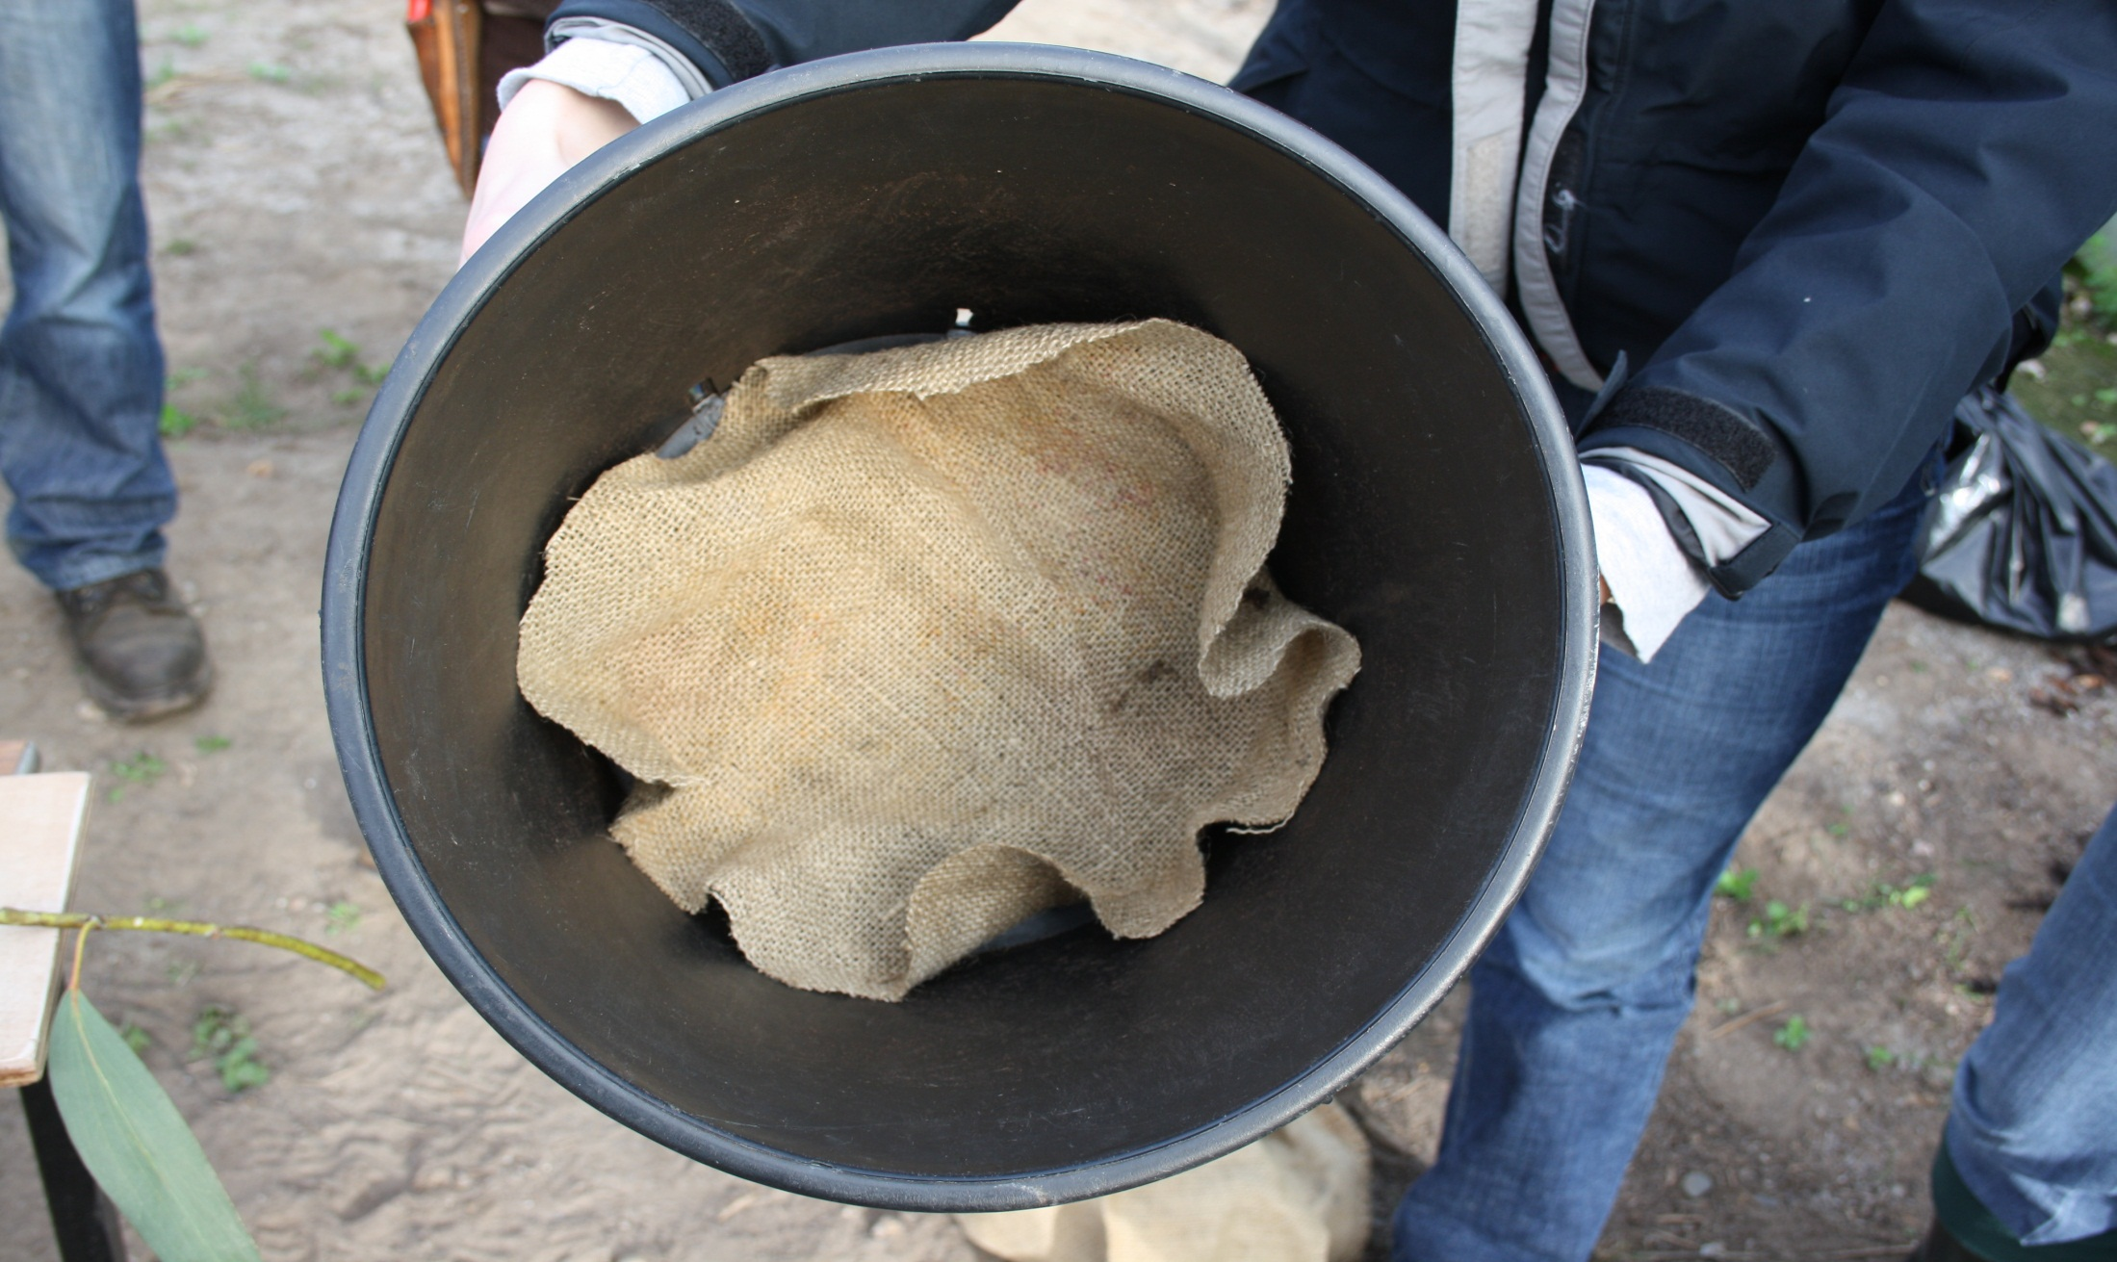
A porous barrier is placed in the pot in order to prevent vine weevil and other harmful pests entering the pot over the winter period.

Slide 33
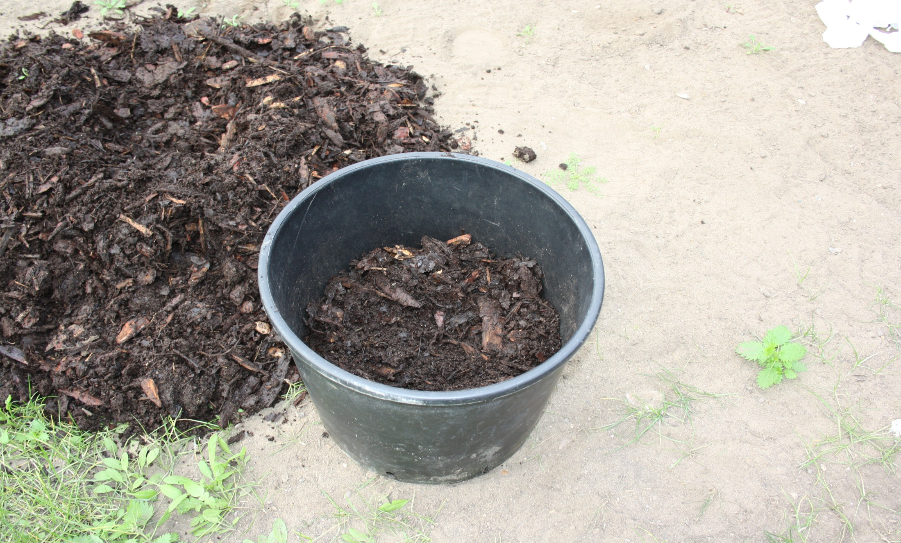
The 50:50 mixture of pine bark and well-rotted organic matter is placed in the container.

Slide 34
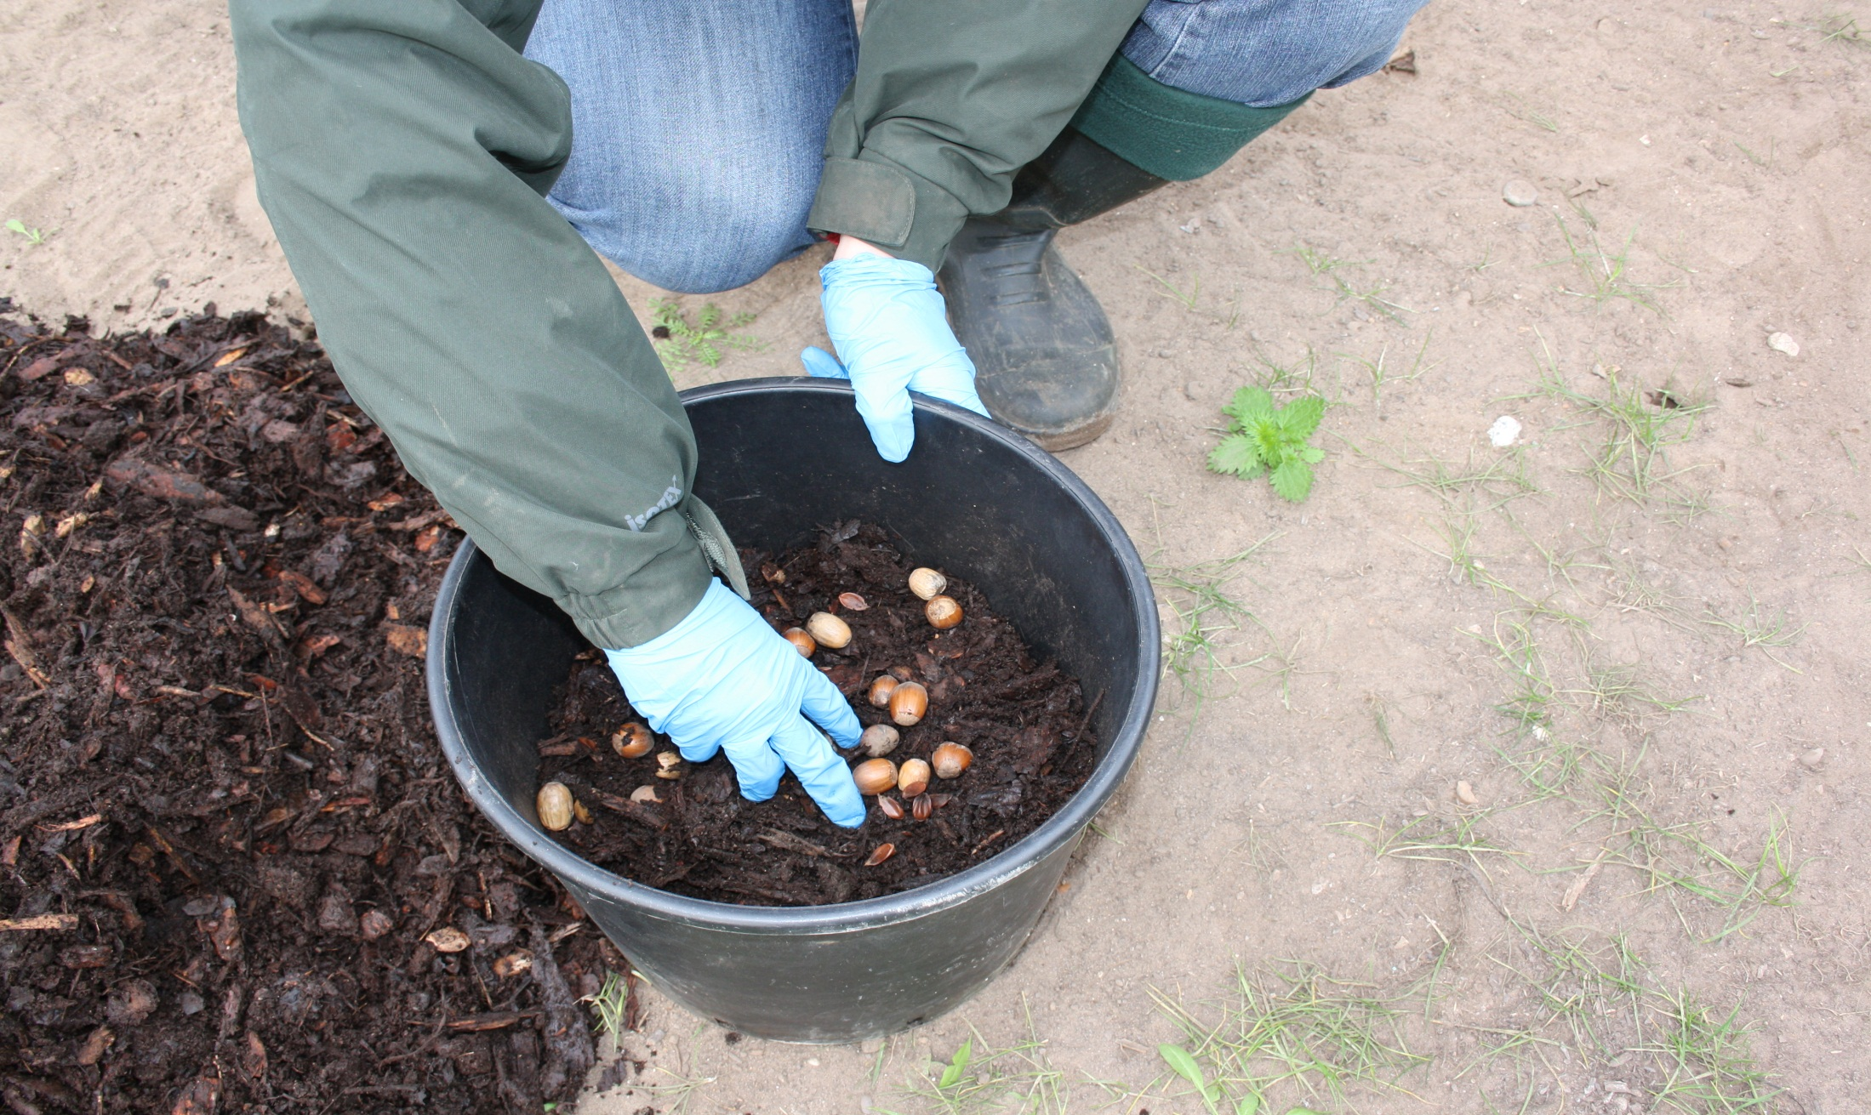
The time is October, the nuts are mixed into pine bark/well-rotted organic matter mix. For the purpose of the photograph, the nuts are mixed in the pot. The nuts, however, are normally mixed with the compost to have a ratio of two-thirds compost and one-third seed by volume.

Slide 35
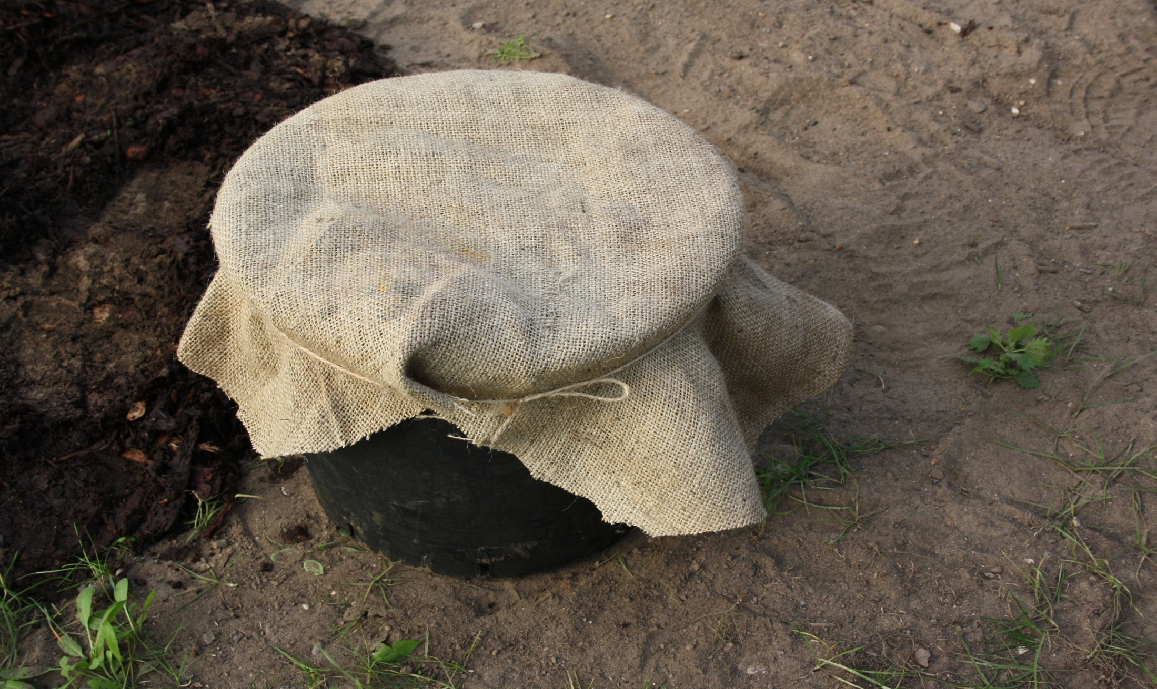
A hessian porous material is placed over the pot. If it is to be left totally outside to be exposed to the winter weather, the string tying the hessian should be replaced with wire in order to prevent vermin damage. The seed will now be stratified over the winter months.

Slide 36
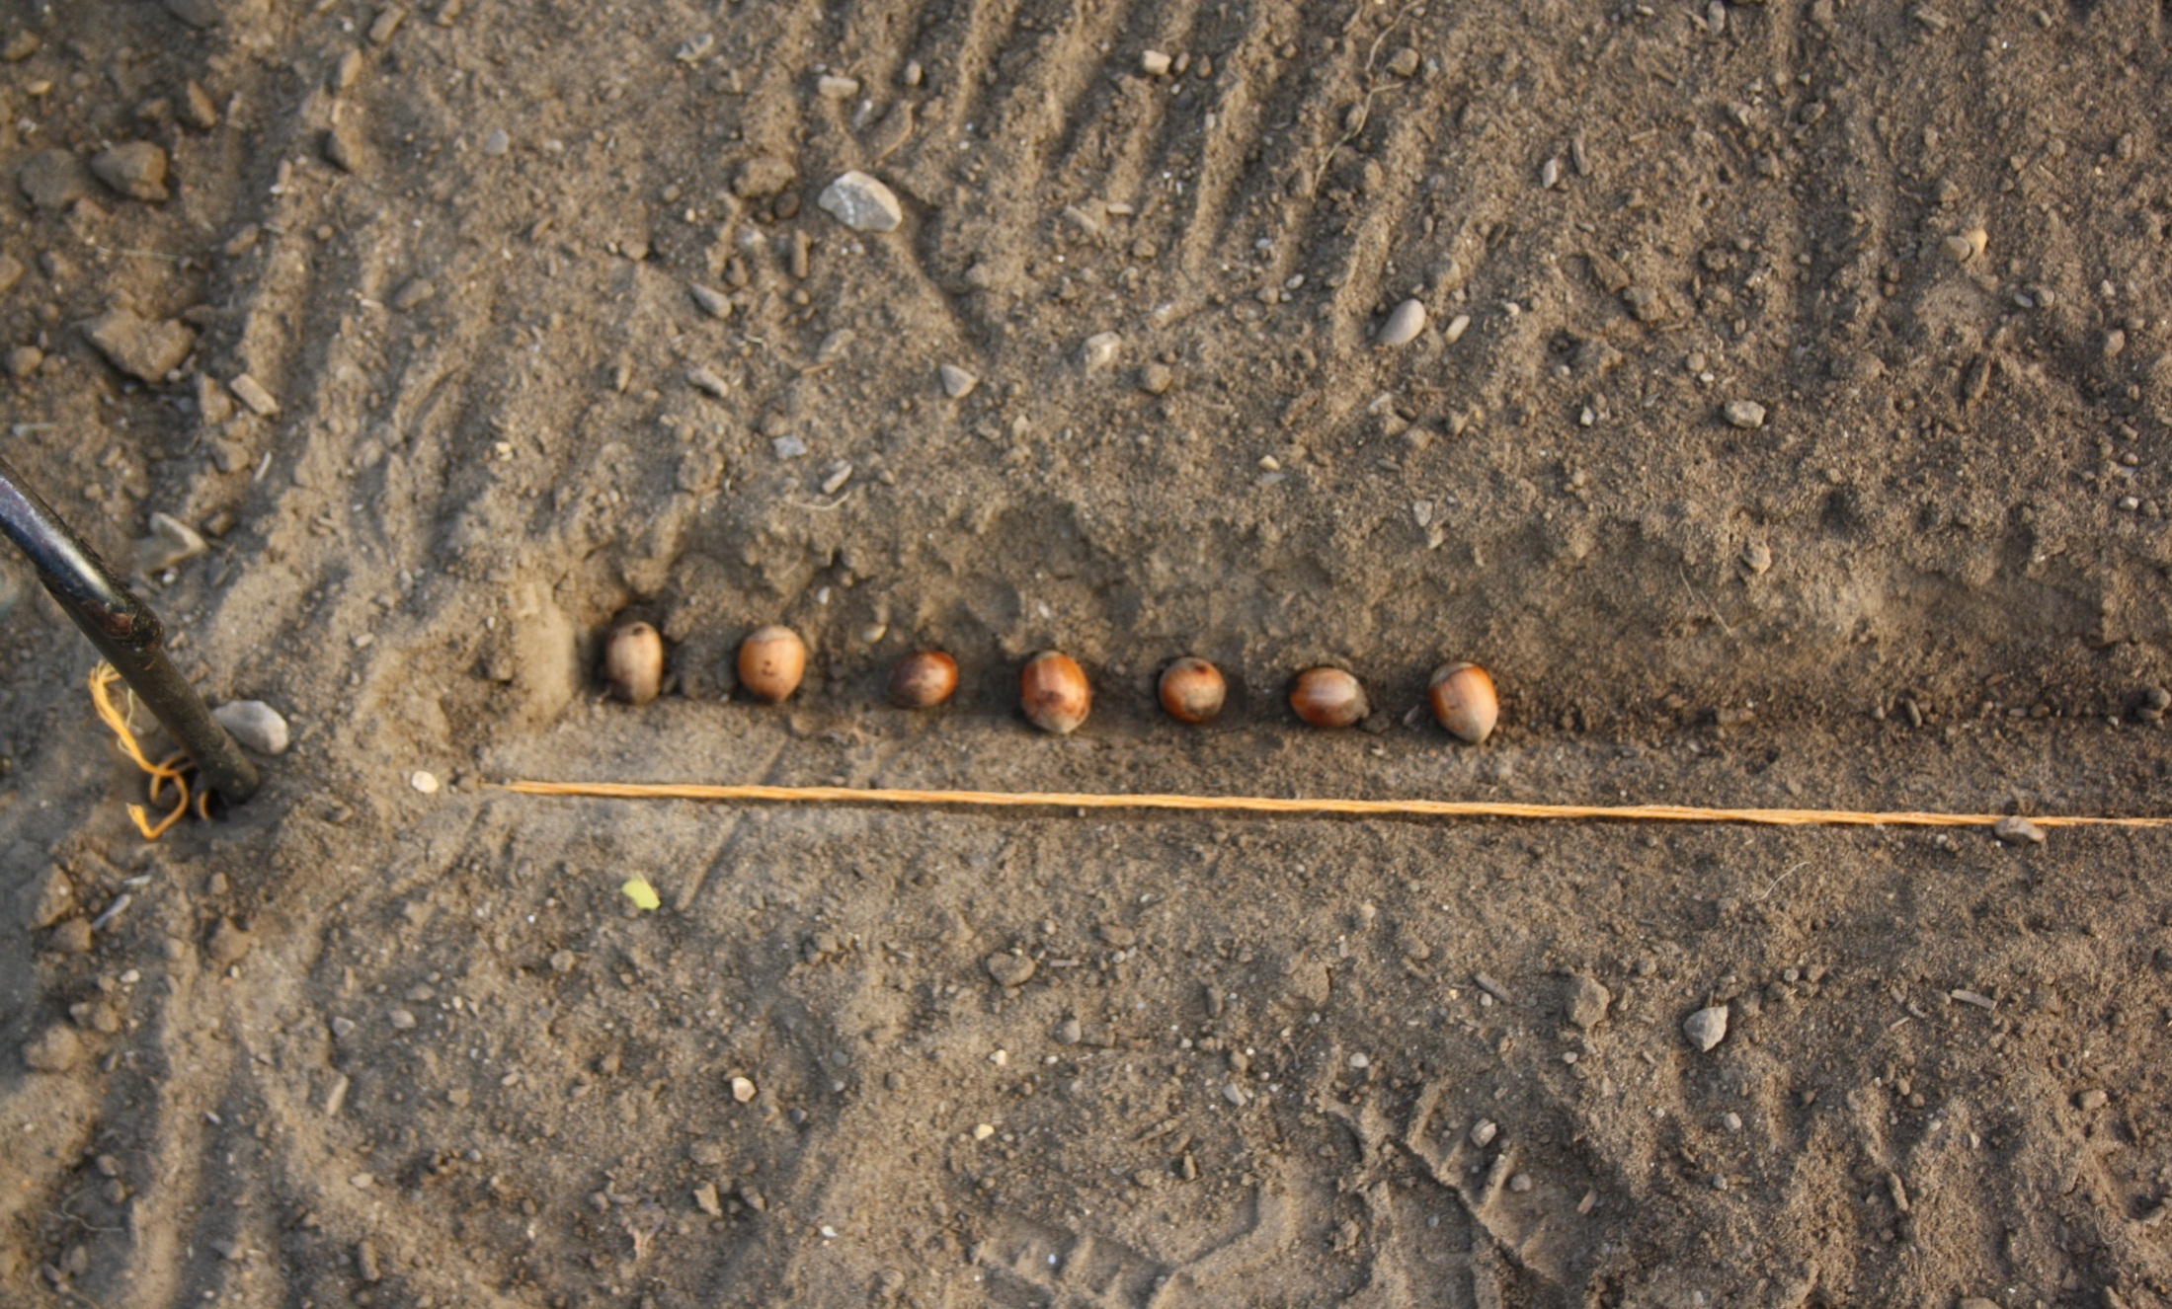
Another method of stratification of seed is to sow the seed in drills or broadcast in the autumn. A shallow drill of 3 cm is used with these Corylus nuts.

Slide 37
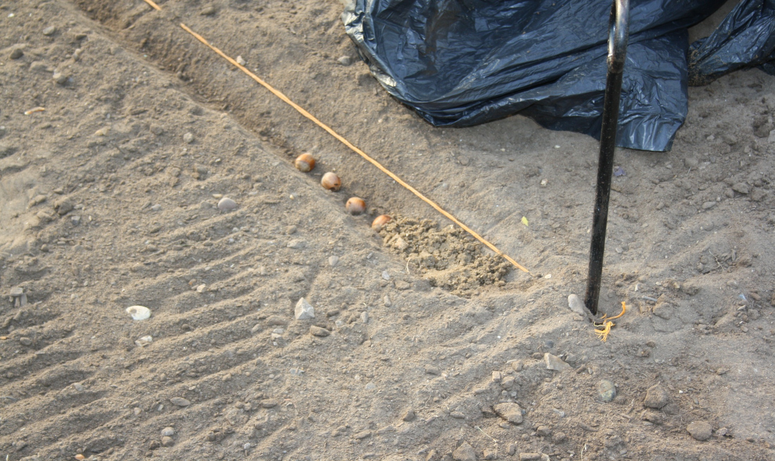
Coarse sand is placed immediately over the nuts. It is important that the drill is exposed by at least 1 cm as shown by the red arrow.

Slide 38
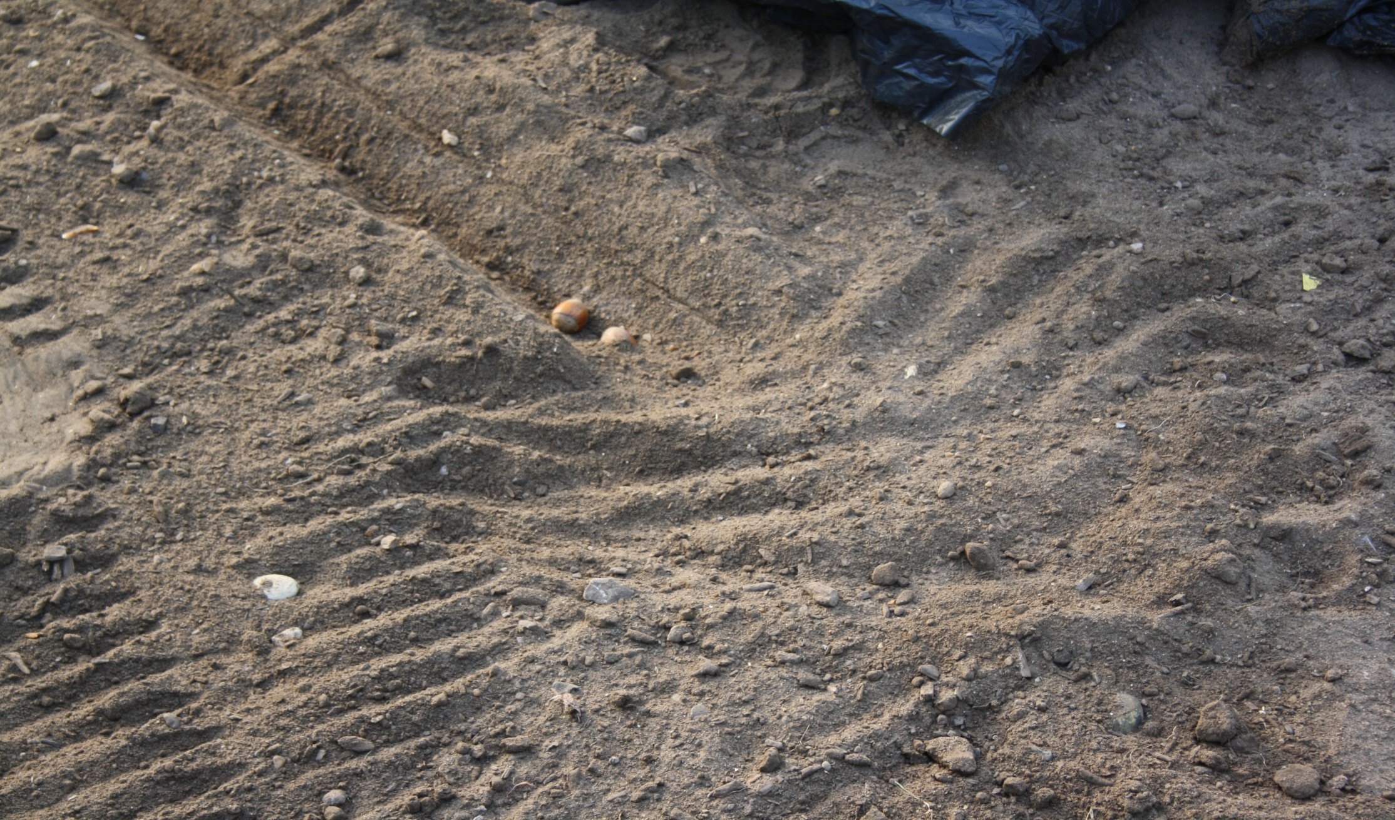
The principle is that over the winter months the surrounding soil will fill the drill as a result of rain and ice moving the soil. This method prevents compaction of the soil over the long period the seed is in the soil, which is from October to March.

Slide 39
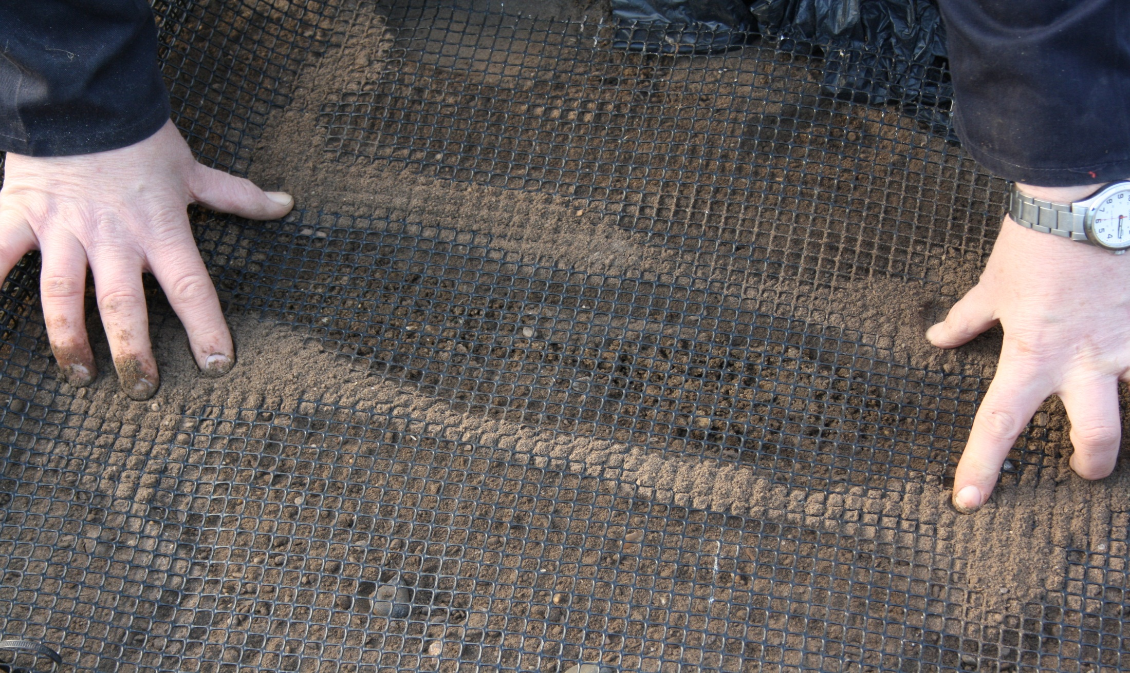
It is important with this method to net the drill, in order to prevent vermin from digging up the seed.

Slide 40
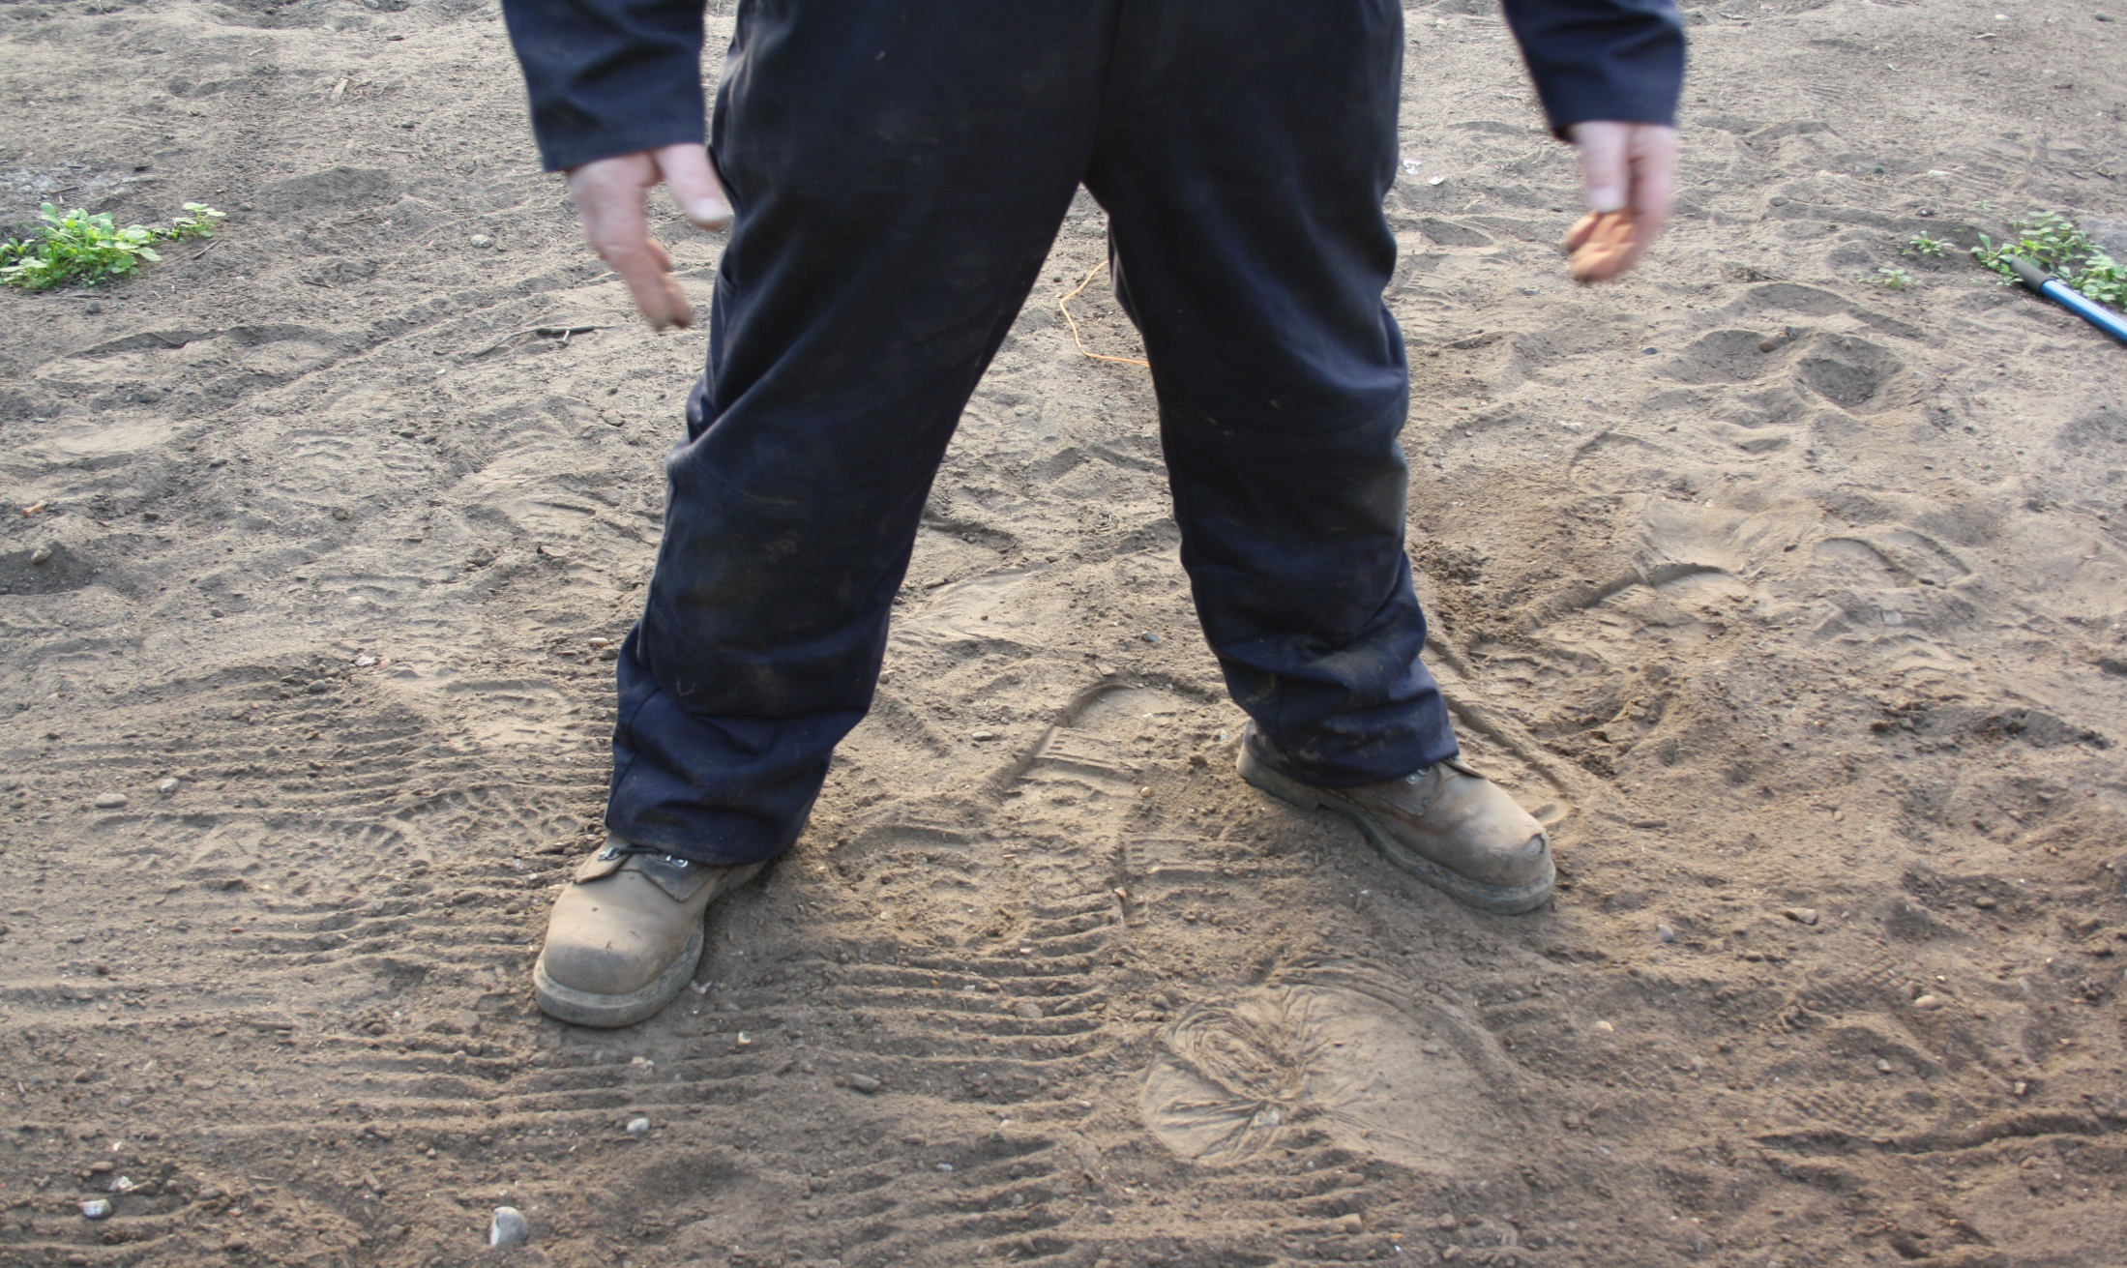
In working out the width of the raised bed, it is important to find a comfortable working posture, this will clearly be different for individuals of different heights.

